Slide 1
Results and Comparisons from the RISE Adult Medication Study
The RISE Consortium

Slide 2
Adult Medication Study
Rationale, Trial Design and
Statistical Approach

Slide 3
Age-adjusted Prevalence of Diagnosed Diabetes Among US Adults: 2000-2015
2000
2015
No Data <4.5% 4.5%–5.9% 6.0%–7.4% 7.5%–8.9% >9.0%
CDC’s Division of Diabetes Translation. United States Diabetes Surveillance System available at http://www.cdc.gov/diabetes/data

Slide 4
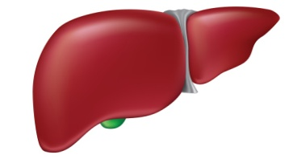
Physiological Regulation of β-cell Responses by Insulin Sensitivity
Insulin
Sensitive
Insulin
Resistance
Reduced
Insulin
Response
Enhanced
Insulin
Response
Insulin
Response
Notes:
1/18

Slide 5
Longitudinal Follow-up of Pima Indians: Insulin Sensitivity and β-Cell Function
500
400
Non-progressors n=31
300
NGT
AIRglucose (µU/ml)
NGT
NGT
200
NGT
IGT
100
DM
Progressors n=17
0
0
1
2
3
4
5
M-low (mg/kg EMBS per minute)
Adapted from Weyer C et al: J Clin Invest 104:787-794; 1999
Notes:
https://www.jci.org/articles/view/7231/pdf

Slide 6
β-cell Function Decreases in IFG/IGT and Diabetes Mellitus in Different Ethnic Groups
25
African American (n=55)
20
Asian American (n=66)
Caucasian (n=217)
(∆I₃₀ / ∆G₃₀₎) /
HOMA
Resistance
Index
(mmol⁻²)
Latino/Hispanic (n=193)
15
10
5
0
NGT
IFG/IGT
Diabetes
Jensen CC et al: Diabetes 51:2170-2178; 2002
Notes:
https://www.jci.org/articles/view/7231/pdf

Slide 7
Overall Aim of The RISE Consortium
To identify approaches that can preserve or improve β-cell function in youth and adults with dysglycemia.

Slide 8
RISE Protocols
Comparing medications
Pediatric Medication Study
(10-19 years)
Adult Medication Study
(20-65 years)
Comparing surgical vs. medical intervention
Adult Surgery (BetaFat) Study
(22-65 years)
Proof-of-Principle Studies
The RISE Consortium: Diabetes Care 37:780-788; 2014
Notes:
The Restoring Insulin Secretion Study or RISE includes 3 proof of principle randomized clinical trials
(Click) 2 of which are comparing medications, a Pediatric Medication Study in youth ages 10-19 and an Adult Medication Study in adults 20-65 years of age.
(click) and a 3rd study comparing surgical vs. medical intervention known as the Adult Surgery or BetaFat Study in adults ages 22 to 65 years.
(click) Today we will present the primary results from Adult Medication Study
(click) as well as the primary outcome results comparing adults to children

Slide 9
RISE Adult Medication Study Question
In adults with IGT or recently diagnosed type 2 diabetes, can β-cell function be preserved or improved during 12 months of pharmacologic intervention, and maintained for 3 months following the withdrawal of therapy?

Slide 10
RISE Adult Medication Study Treatment Arms
Blinded metformin alone and matched placebo:
Metformin titrated over 4 weeks from 500 mg/day to 1,000 mg BID
Liraglutide + Metformin:
Liraglutide titrated over 4 weeks from 0.6 mg/day to 1.8 mg/day
Metformin titrated as above after liraglutide dose stable
Glargine followed by metformin:
Once daily insulin glargine, titrated twice weekly over one month based on SMBG to goal of 80-90 mg/dL
Glargine discontinued and metformin titrated after 3 months

Slide 11
Rationale for Use of Metformin
1.2
∆I₀₋₃₀ / ∆G₀₋₃₀
([µU/ml]/[mg/dl])
Placebo (n=1082)
1.0
Metformin (n=1073)
Lifestyle (n=1079)
0.04
0.05
0.06
1 / Fasting Insulin ([µU/ml]⁻¹)
Adapted from DPP Research Group: Diabetes 54: 2404-2414; 2005

Slide 12
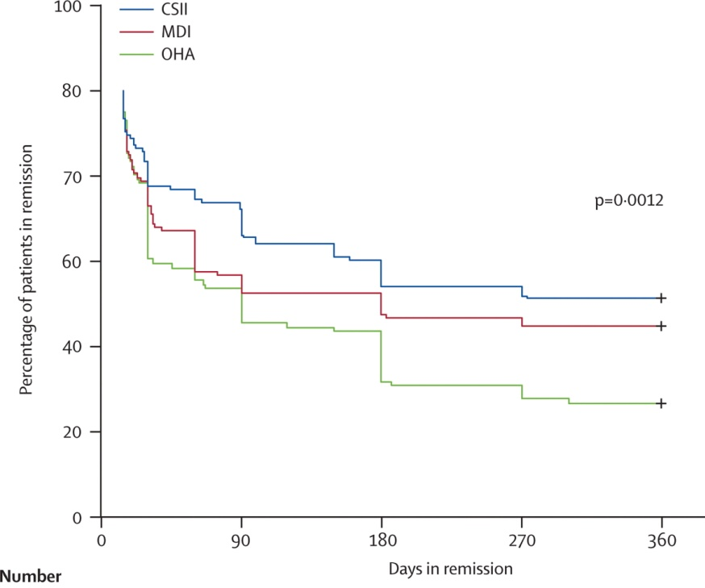
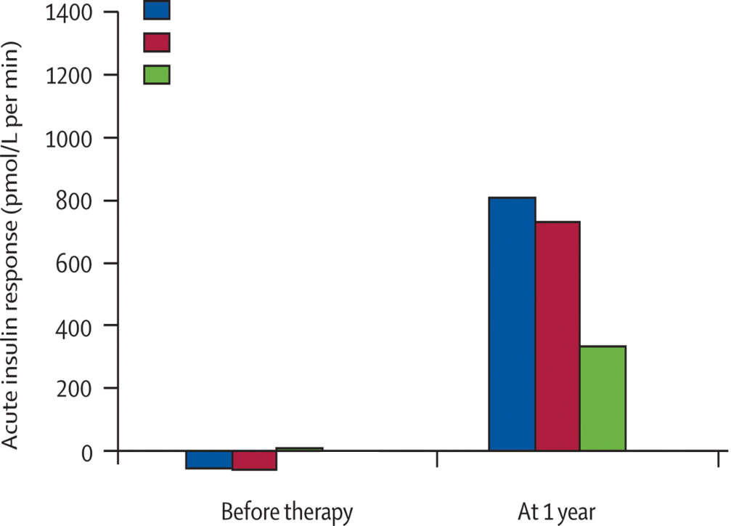
Rationale for Use of Insulin
In remission group:
Insulin pump
Multiple daily injections
Oral agent / no insulin
Insulin pump
Multiple daily injections
Oral agent / no insulin
Patients in remission (%)
Percentage of patients in remission
Days in remission
Adapted from Weng J et al: Lancet 371:1753-1760; 2008

Slide 13
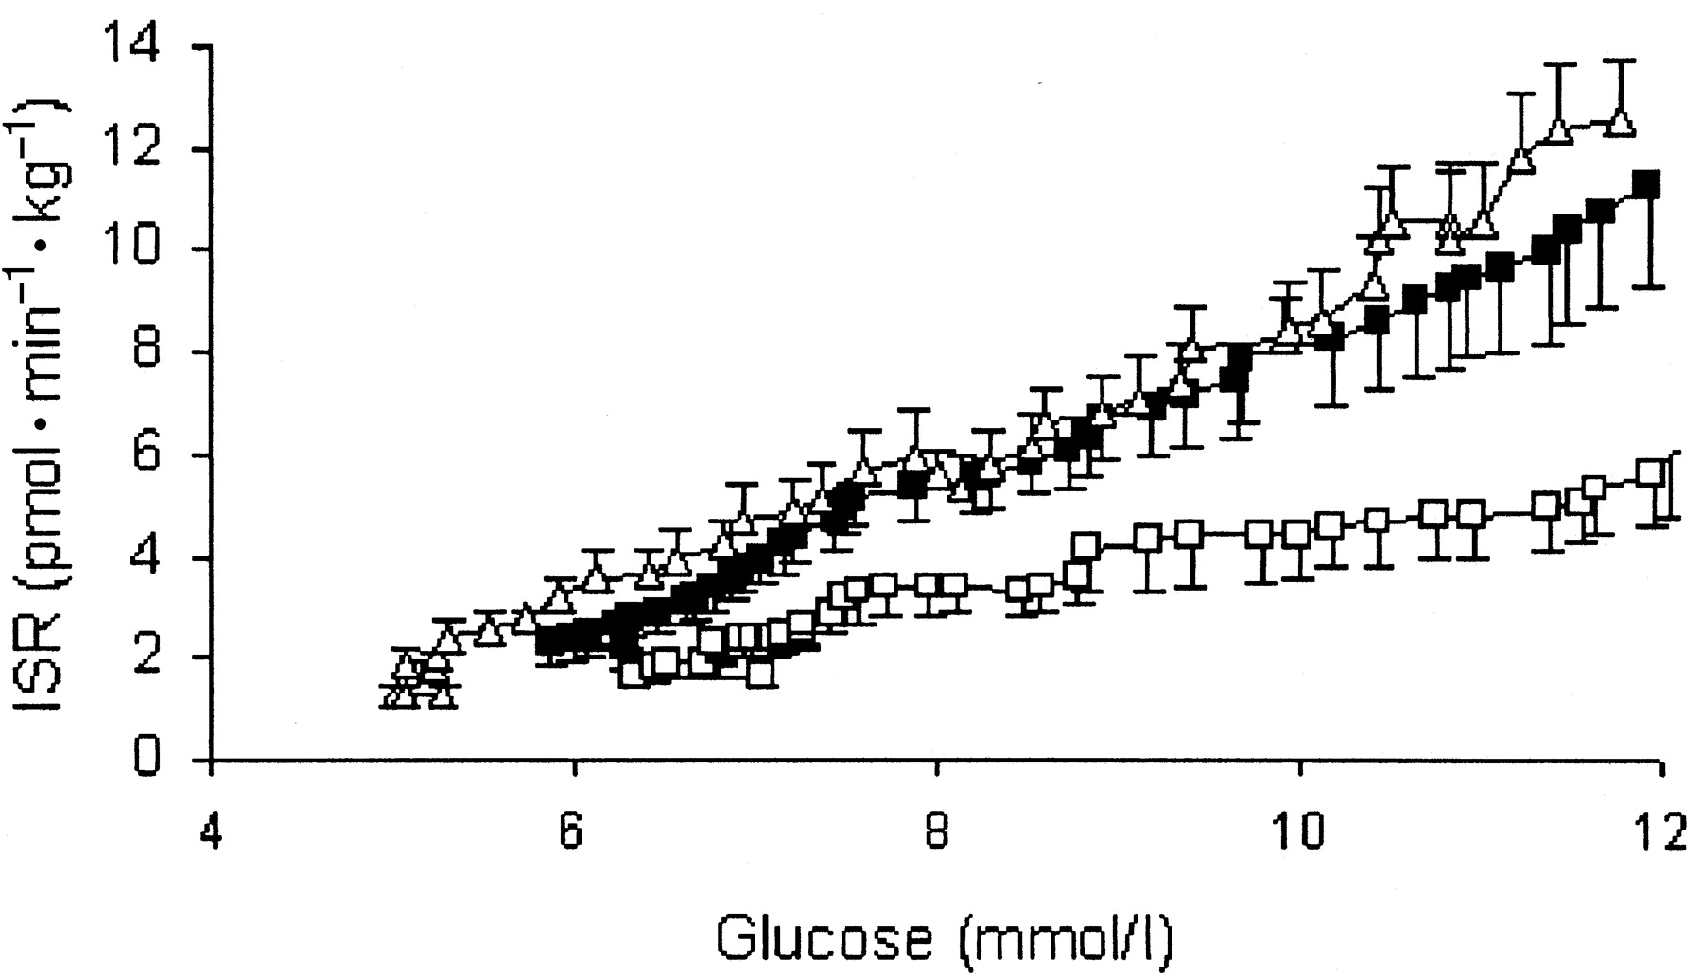
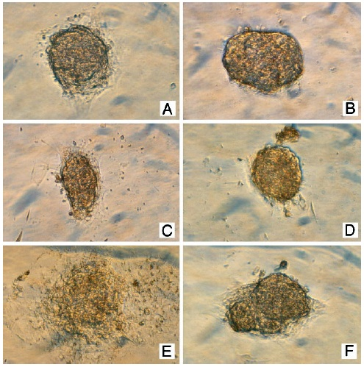
Rationale for Use of Liraglutide
Control
GLP-1 10 nM
□ T2D, pre-treatment
■ T2D, post-treatment
Δ Controls
Day 1
ISR (pmol • min⁻¹ • kg⁻¹)
Day 3
Day 5
Glucose (mmol/l)
Chang AM, et al. Diabetes 52:1786-1792; 2003
Farilla L et al. Endocrinology 144:5149-5158; 2003

Slide 14
Inclusion Criteria
Criteria
Age (years) | 20-65
Body mass index (kg/m²) | 25-50
Fasting plasma glucose (mg/dL) | 95-125
2-hour OGTT glucose (mg/dL) | ≥140
Diabetes duration (years) | <1
Diabetes medication status | Naïve
HbA1c (%) | ≤7.0
The RISE Consortium: Diabetes Care 37:780-788; 2014

Slide 15
Medication Study Protocols: Study Phases and Key Time Points
Hyperglycemic Clamp
OGTT
Hyperglycemic Clamp
OGTT
Primary Outcome
Screening
Run-in (3 weeks)
Active Treatment (12 months)
Washout (3 months)
Baseline
Randomization
12 months
15 months
The RISE Consortium: Diabetes Care 37:780-788; 2014
Notes:
(click) This post-washout visit represents the primary outcome for the RISE Medication Studies.

Slide 16
Two-step Hyperglycemic Clamp Protocol
Two-step Hyperglycemic Clamp Protocol
Insulin sensitivity (M/I)
Steady-State Glucose Infusion Rate (M)
Steady-State Insulin Concentrations (I)
Steady-state
Variable rate 20% dextrose infusion
Glucose
bolus
Glucose
bolus
.
.
.
.
Time (minutes)
The RISE Consortium: Diabetes Care 37:780-788; 2014
Notes:
11/18

Slide 17
Two-step Hyperglycemic Clamp Protocol
Two-step Hyperglycemic Clamp Protocol
β-cell Responses
Acute C-peptide
Response to
Arginine (ACPR_{max})
Steady-state
Steady-state
C-peptide
Acute C-peptide
Response to
Glucose (ACPR_{g})
Variable rate 20% dextrose infusion
Glucose
bolus
Glucose
bolus
.
.
.
Time (minutes)
The RISE Consortium: Diabetes Care 37:780-788; 2014
Notes:
11/18

Slide 18
Power and Sample Size Considerations
β-cell function co-primary outcomes (steady-state C-peptide and ACPRmax) analyzed separately each with a type I error of α=0.05
Power set at 80%
Powered using a 2-sided type I error of α=0.05 in a closed-testing procedure to preserve type I error:
Initially, all 4 groups are compared.
If significant, each possible 3-group comparison is completed.
If significant, each possible 2-group comparison is completed.
The RISE Consortium: Diabetes Care 37:780-788; 2014

Slide 19
Baseline Characteristics
Criteria | Glargine → Met (n=67) | Lira + Met (n=68) | Met alone (n=65) | Placebo (n=67)
Female, n (%)* | 23 (34%) | 29 (43%) | 37 (57%) | 25 (37%)
Age (years) | 54 ± 9 | 54 ± 8 | 55 ± 8 | 53 ± 10
White, n (%) | 37 (55%) | 40 (59%) | 34 (52%) | 30 (45%)
Black, n (%) | 21 (31%) | 20 (29%) | 19 (29%) | 21 (31%)
Hispanic, n (%) | 5 (8%) | 6 (9%) | 6 (9%) | 11 (16%)
* p=0.044 for treatment group difference

Slide 20
Baseline Characteristics
Criteria | Glargine → Met (n=67) | Lira + Met (n=68) | Met alone (n=65) | Placebo (n=67)
Weight (kg) | 104 ± 20 | 104 ± 21 | 98 ± 19 | 102 ± 19
BMI (kg/m²) | 35 ± 6 | 36 ± 6 | 35.0 ± 5 | 34 ± 6
Diabetes, n (%) | 17 (25%) | 19 (27.9%) | 16 (24.6%) | 18 (26.9%)
HbA1c (%) | 5.8 ± 0.3 | 5.7 ± 0.4 | 5.8 ± 0.4 | 5.7 ± 0.4
Fasting glucose (mg/dL) | 112 ± 13 | 110 ± 9 | 112 ± 12 | 110 ± 11
2-h glucose (mg/dL) | 185 ± 42 | 178 ± 39 | 181 ± 43 | 182 ± 41
No differences in blood pressure, lipid levels, BP or lipid lowering medication use.

Slide 21
Summary
The RISE Adult Medication Study randomized 267 individuals with IGT or recently-diagnosed type 2 diabetes.
Baseline characteristics were well matched across the four treatment groups:
Glargine followed by Metformin
Liraglutide + Metformin
Metformin Alone
Placebo

Slide 22
Adult Medication Study
Baseline Characteristics and
Primary Outcome

Slide 23
CONSORT Diagram
Enrollment
Assessed for eligibility (n=1204)
Begin run-in period (n=312)
Baseline Visit (n=275)
Randomized (n=267)
Allocation
Glargine → Metformin
(n=67)
Liraglutide + Metformin
(n=68)
Metformin Alone
(n=65)
Placebo
(n=67)
Month 12 Visit (n=64)
Month 12 Visit (n=54)
Month 12 Visit (n=56)
Month 12 Visit (n=59)
Follow-Up
Primary Outcome Visit
Month 15 Visit (n=65)
Primary Outcome Visit
Month 15 Visit (n=53)
Primary Outcome Visit
Month 15 Visit (n=56)
Primary Outcome Visit
Month 15 Visit (n=58)

Slide 24
Medication Dose and Adherence
Glargine
Dose:
35.2 units/day (0.34 units/kg/day) at 3 months
Adherence (residual volume):
75% of participants were >80% adherent at 3 months
Liraglutide
Dose:
87% of participants taking 1.8 mg/day at 3 months
83% of participants taking 1.8 mg/day at 12 months
Adherence (residual volume):
91% of participants were >80% adherent at 3 months
85% of participants were >80% adherent at 12 months

Slide 25
Medication Dose and Adherence
Metformin dose (2,000 mg/day at 12 months)
88% Glargine/Metformin
84% Metformin Alone
80% Liraglutide + Metformin
98% Placebo
Metformin adherence (% of pills taken at 12 months)
93% Glargine/Metformin
91% Metformin Alone
91% Liraglutide + Metformin
94% Placebo

Slide 26
Insulin Doses and Corresponding
Fasting Glucose Values
Fasting SMBG
% at SMBG goal
Glargine dose
Weeks
Weeks
Weeks
The RISE Consortium: Diabetes Care 42(9):1742-1751; 2019

Slide 27
Glucose Concentrations during Clamp
The RISE Consortium: Diabetes Care 42(9):1742-1751; 2019

Slide 28
C-peptide Concentrations during Clamp
The RISE Consortium: Diabetes Care 42(9):1742-1751; 2019

Slide 29
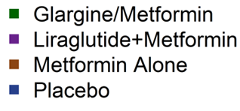
Baseline: M/I, Steady State C-peptide, ACPRmax, ACPRg by Treatment Group
No significant differences across treatment groups at baseline

Slide 30
Month 12: M/I, Steady State C-peptide, ACPRmax, ACPRg by Treatment Group

Slide 31
Month 15: M/I, Steady State C-peptide, ACPRmax, ACPRg by Treatment Group
No significant differences across treatment groups adjusted for baseline

Slide 32
Potential Changes in β-cell Function with Interventions
Improved
Worsened
Notes:
1/18

Slide 33
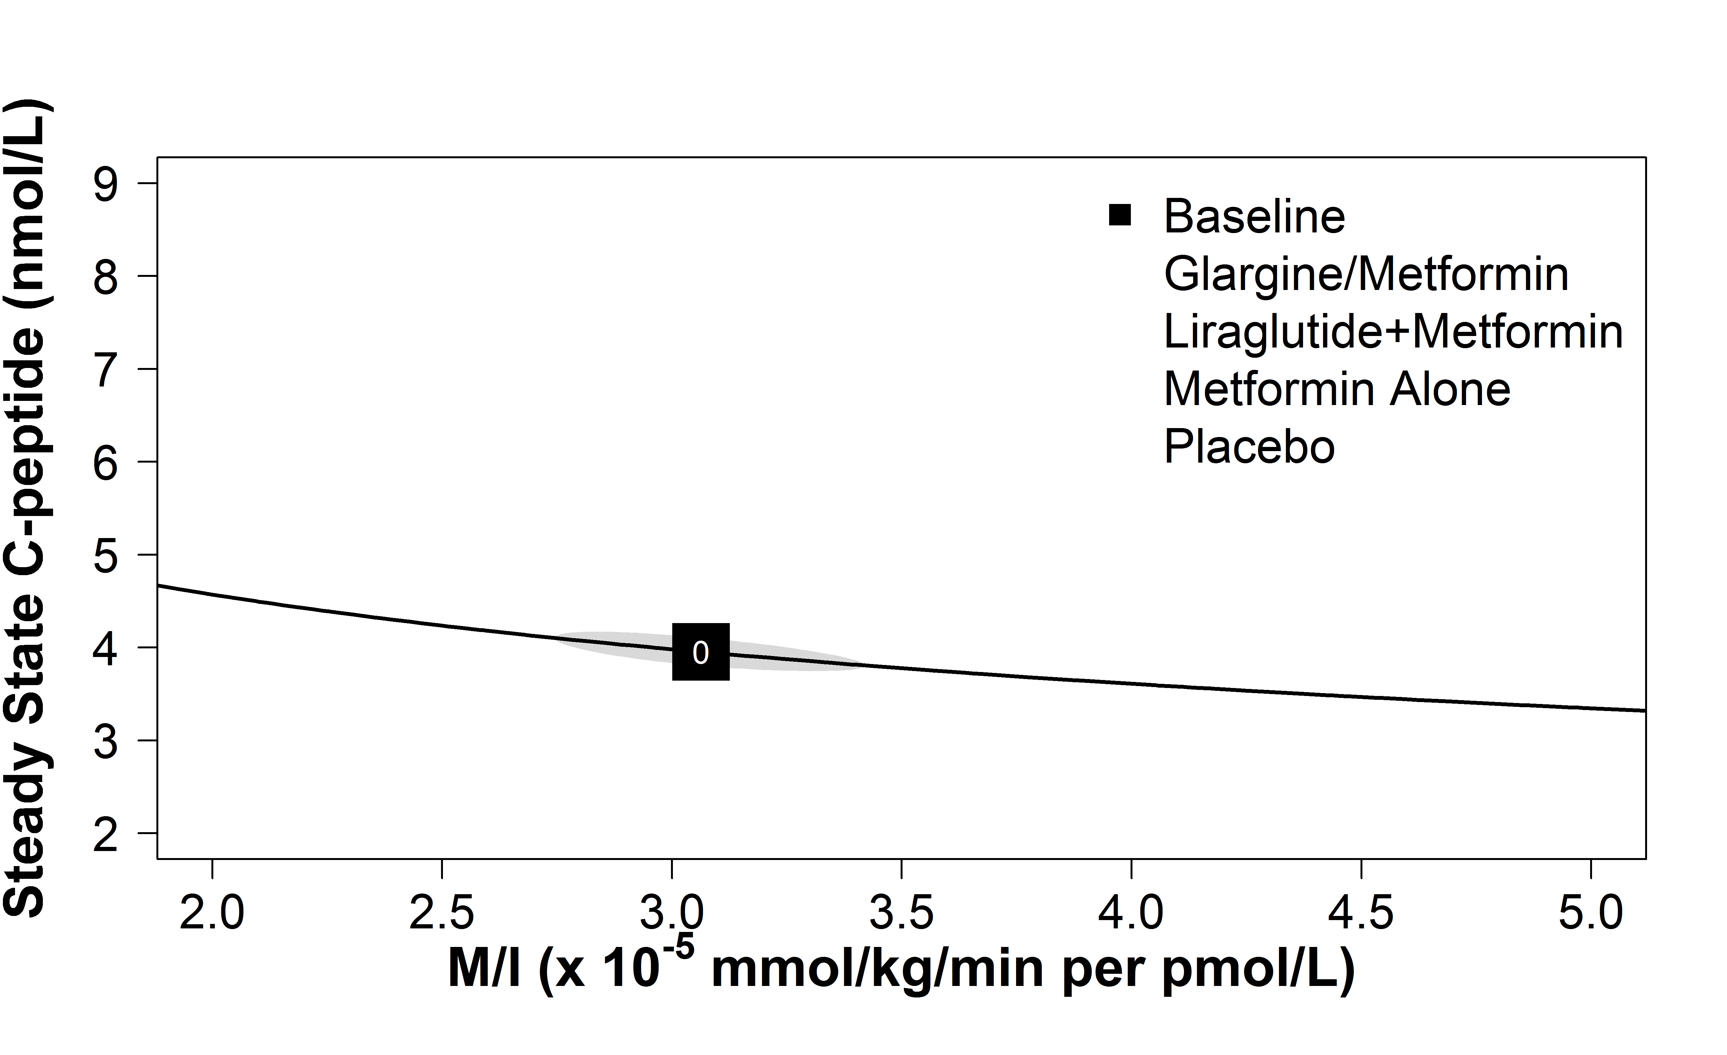
Effects of Study Interventions on β-Cell Function: Steady-State C-peptide
The RISE Consortium: Diabetes Care 42(9):1742-1751; 2019

Slide 34
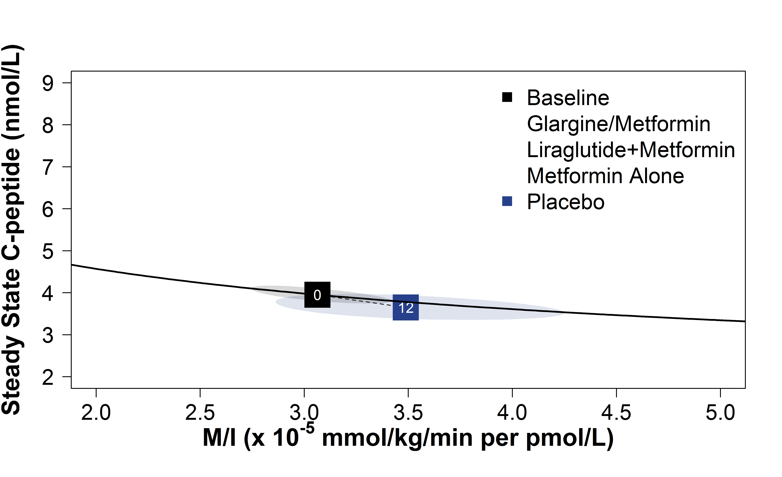
Effects of Study Interventions on β-Cell Function: Steady-State C-peptide
Placebo
The RISE Consortium: Diabetes Care 42(9):1742-1751; 2019

Slide 35
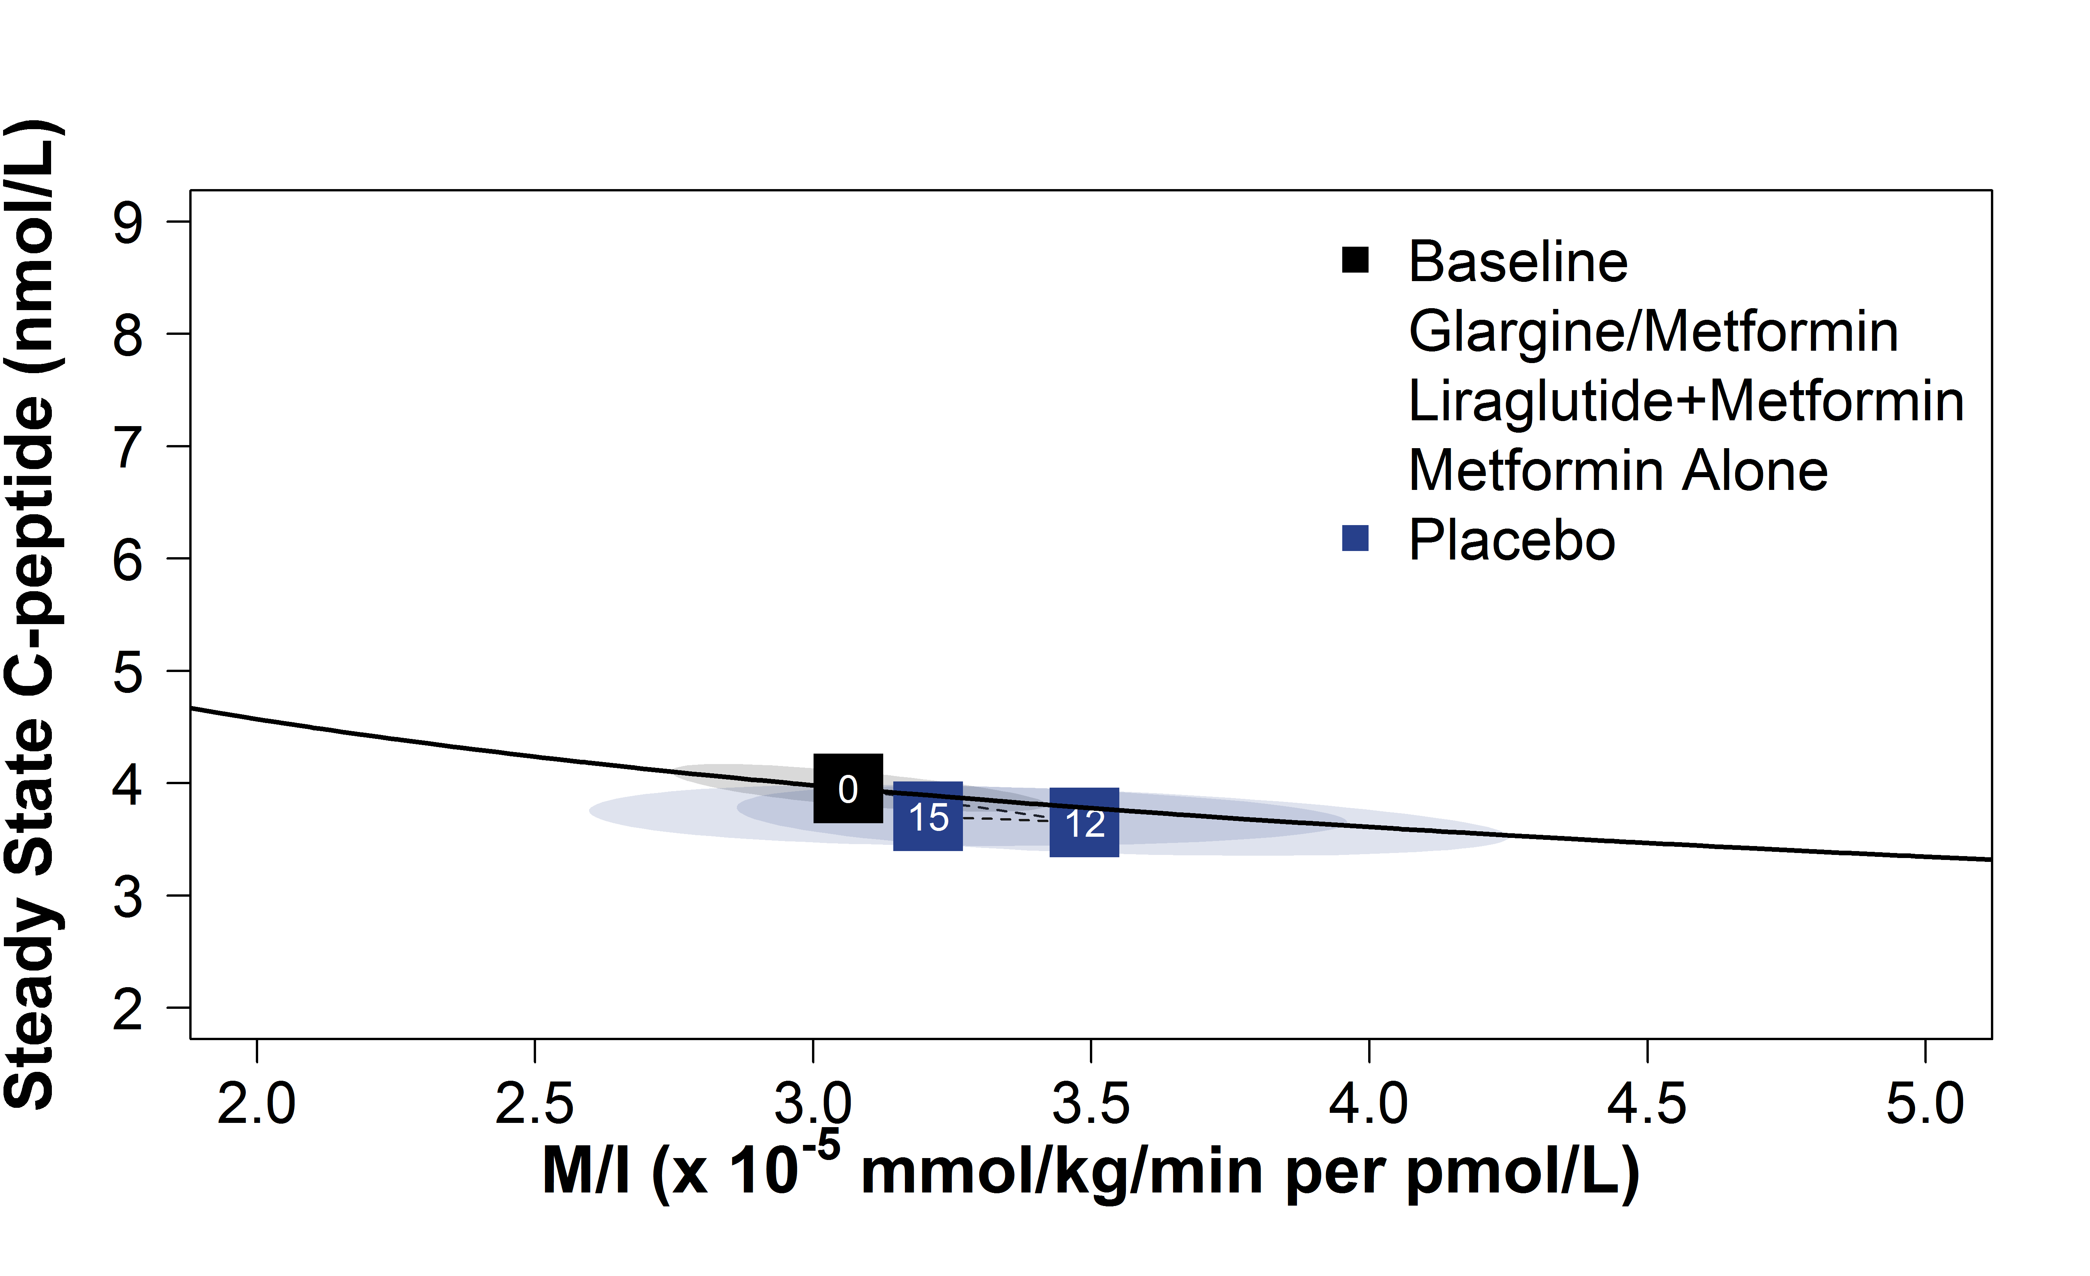
Effects of Study Interventions on β-Cell Function: Steady-State C-peptide
Placebo
The RISE Consortium: Diabetes Care 42(9):1742-1751; 2019

Slide 36
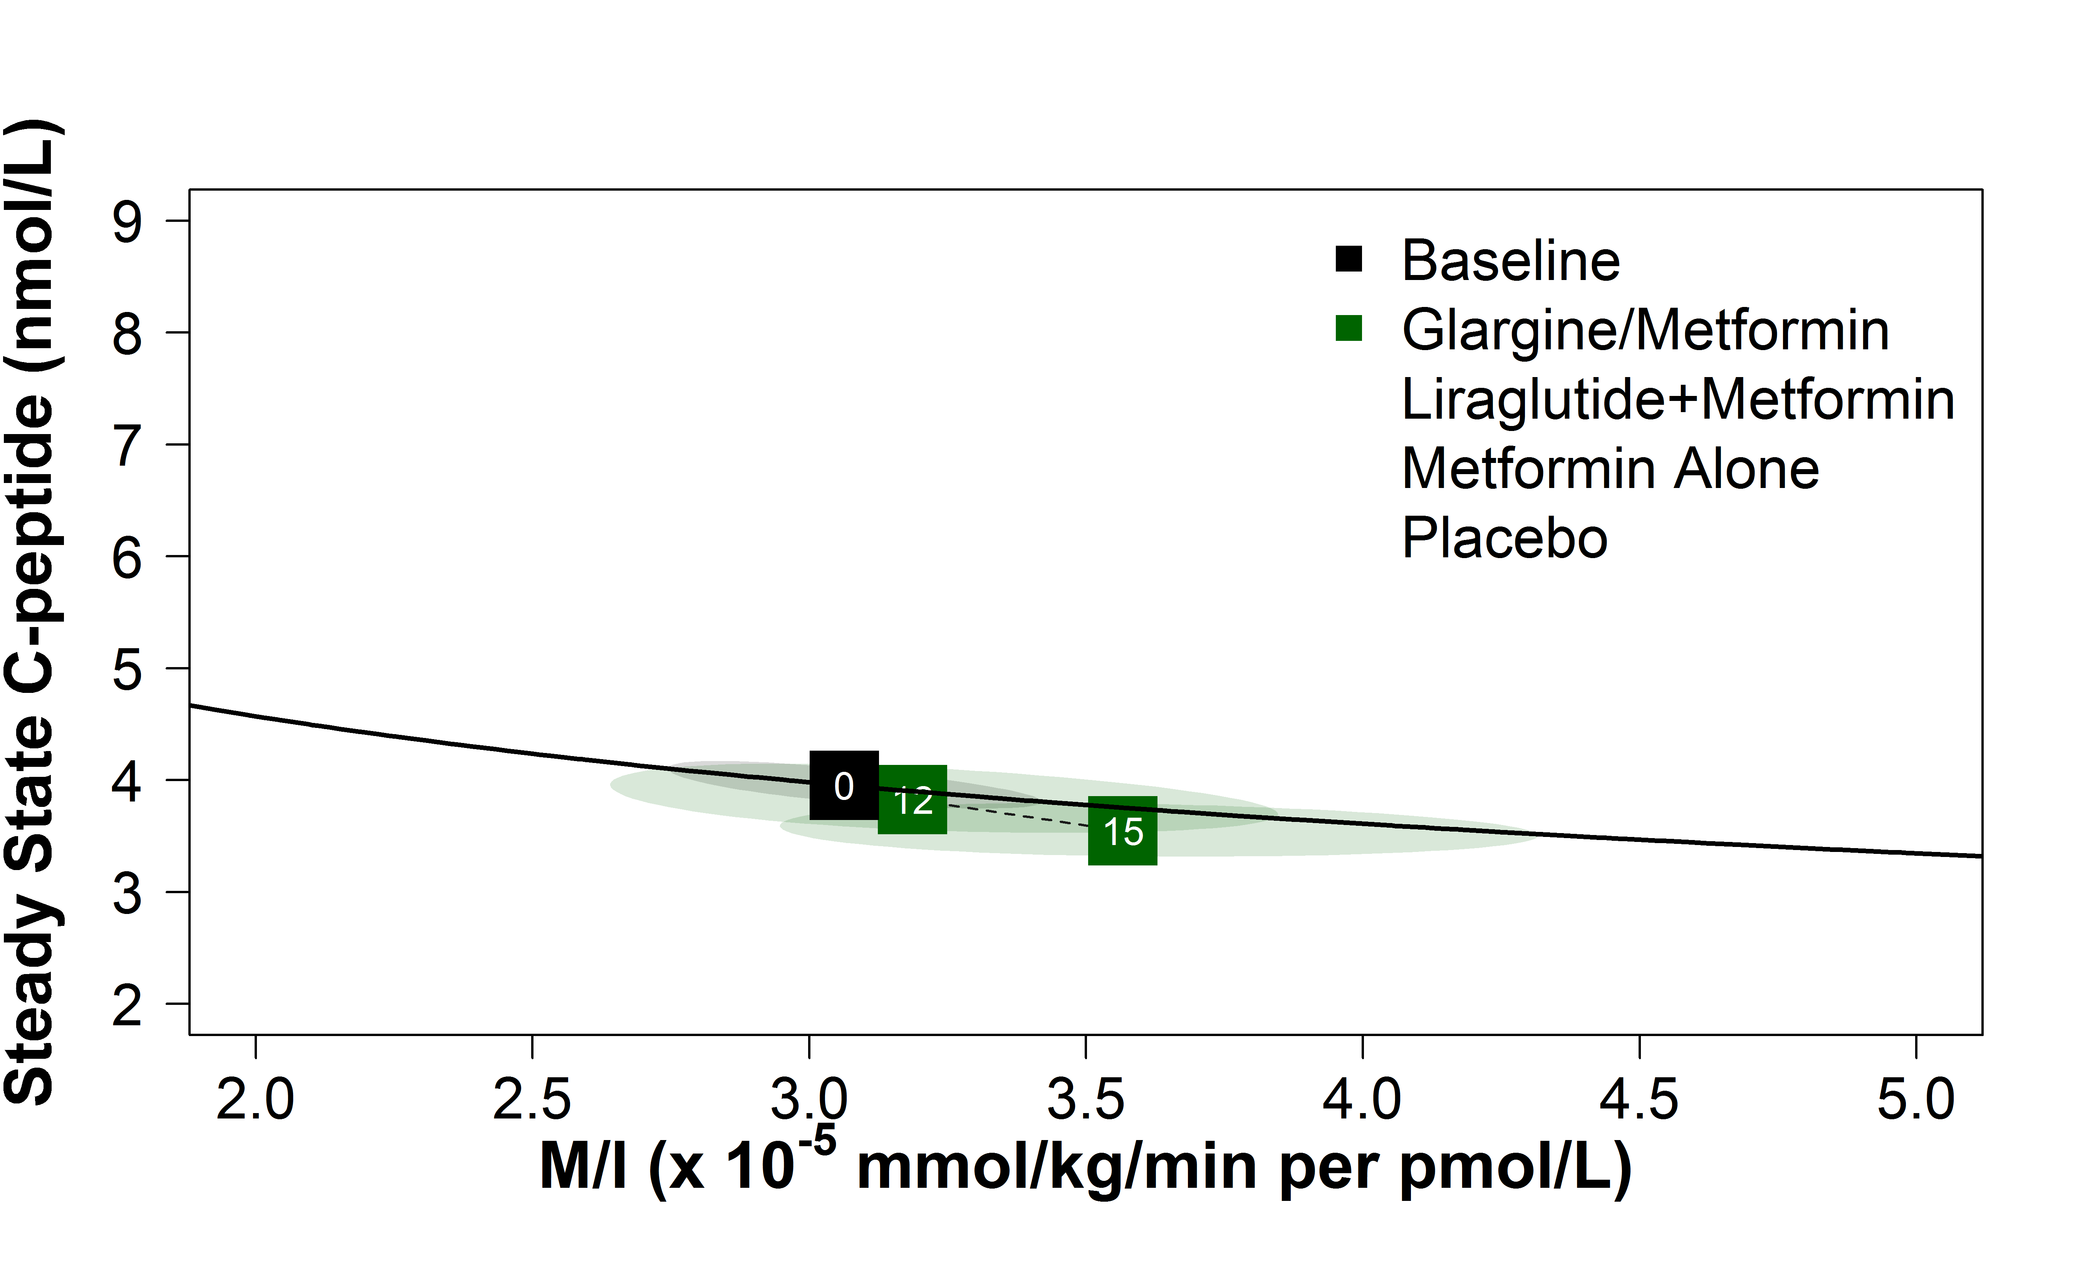
Effects of Study Interventions on β-Cell Function: Steady-State C-peptide
Glargine/Metformin
The RISE Consortium: Diabetes Care 42(9):1742-1751; 2019

Slide 37
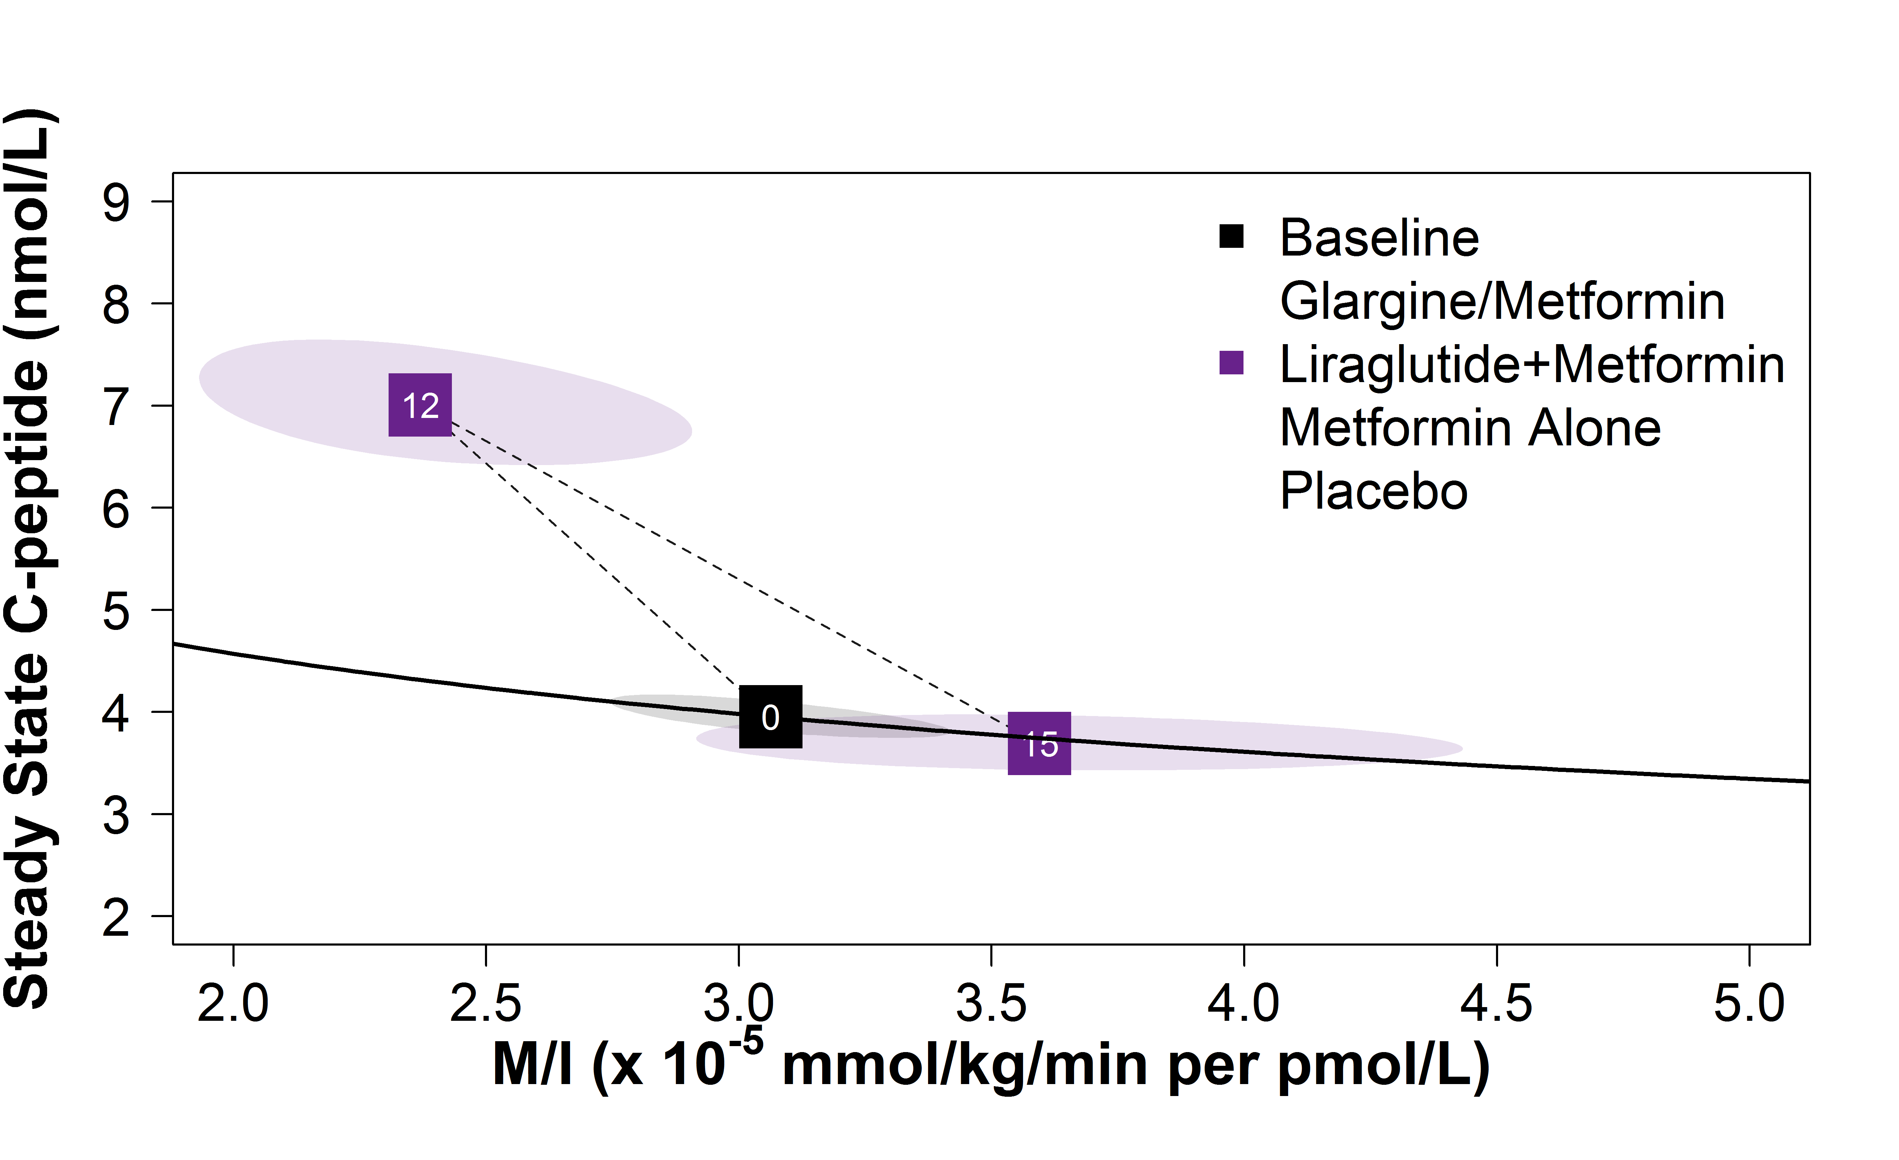
Effects of Study Interventions on β-Cell Function: Steady-State C-peptide
Liraglutide+Metformin
The RISE Consortium: Diabetes Care 42(9):1742-1751; 2019

Slide 38
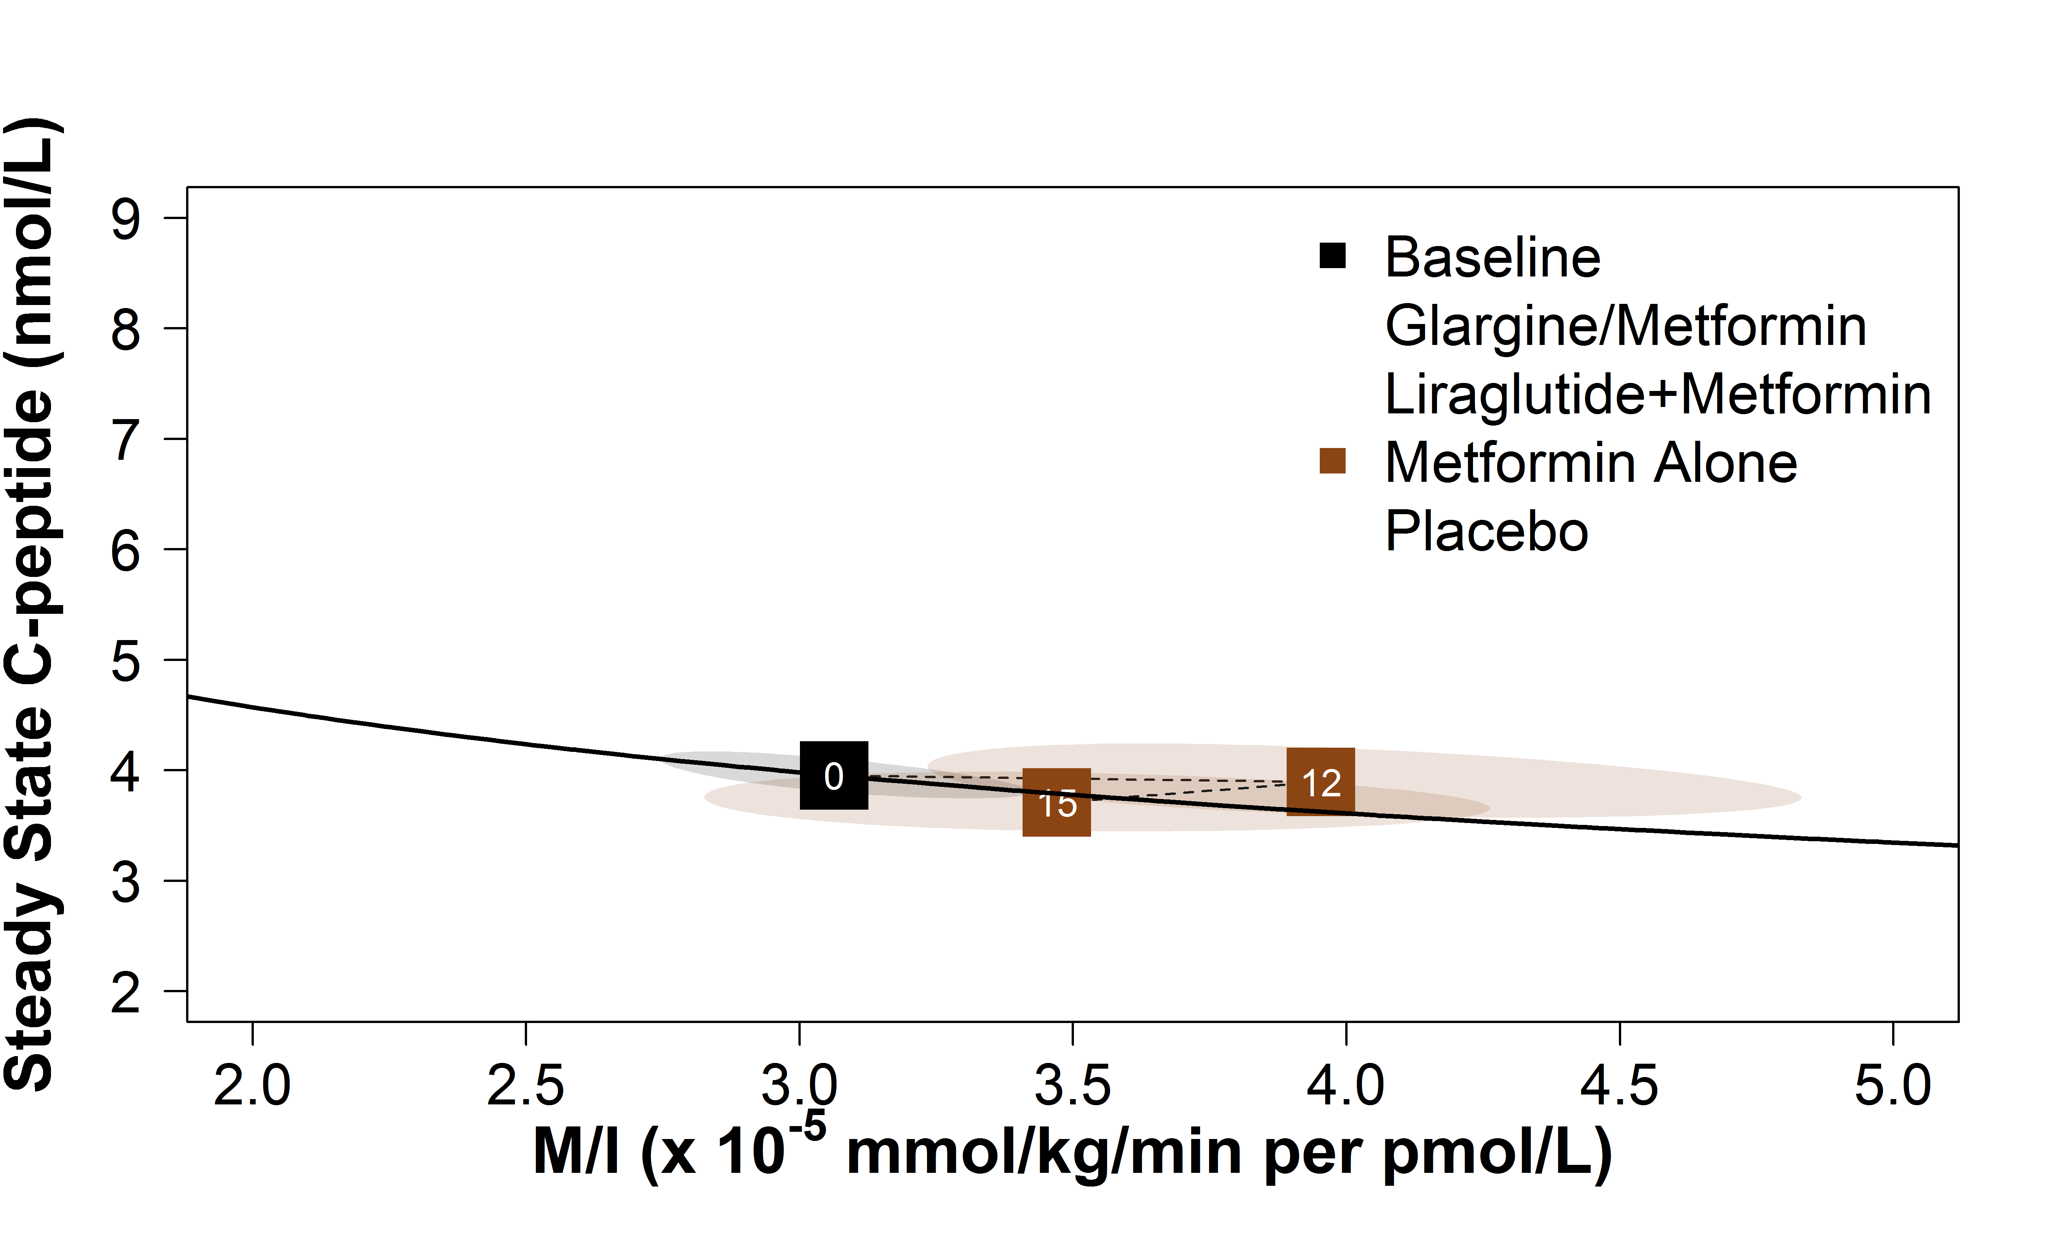
Effects of Study Interventions on β-Cell Function: Steady-State C-peptide
Metformin Alone
The RISE Consortium: Diabetes Care 42(9):1742-1751; 2019

Slide 39
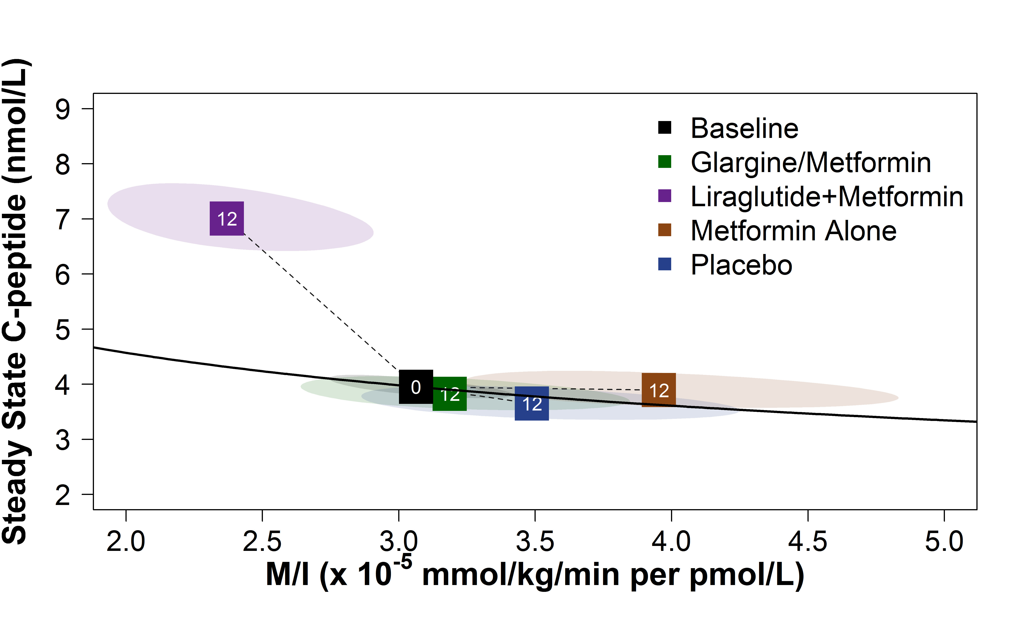
Effects of Study Interventions on β-Cell Function: Steady-State C-peptide
The RISE Consortium: Diabetes Care 42(9):1742-1751; 2019

Slide 40
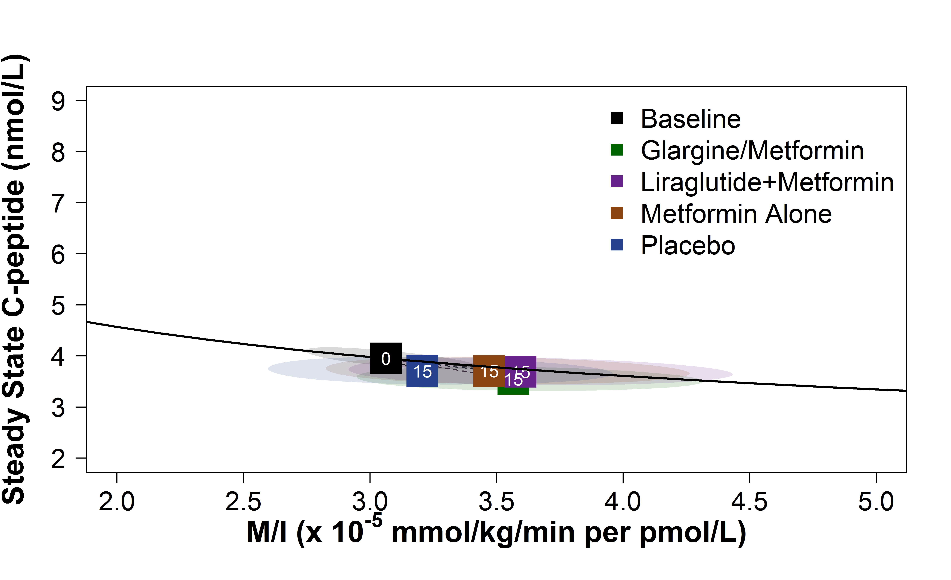
Effects of Study Interventions on β-Cell Function: Steady-State C-peptide
The RISE Consortium: Diabetes Care 42(9):1742-1751; 2019

Slide 41
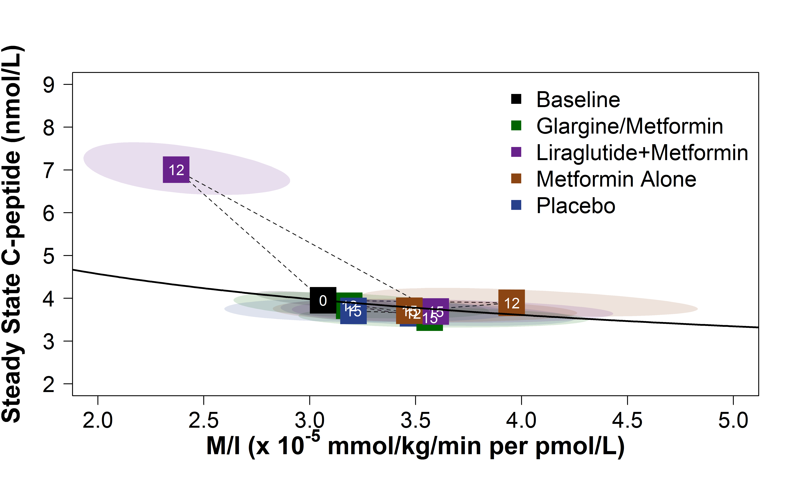
Effects of Study Interventions on β-Cell Function: Steady-State C-peptide
The RISE Consortium: Diabetes Care 42(9):1742-1751; 2019

Slide 42
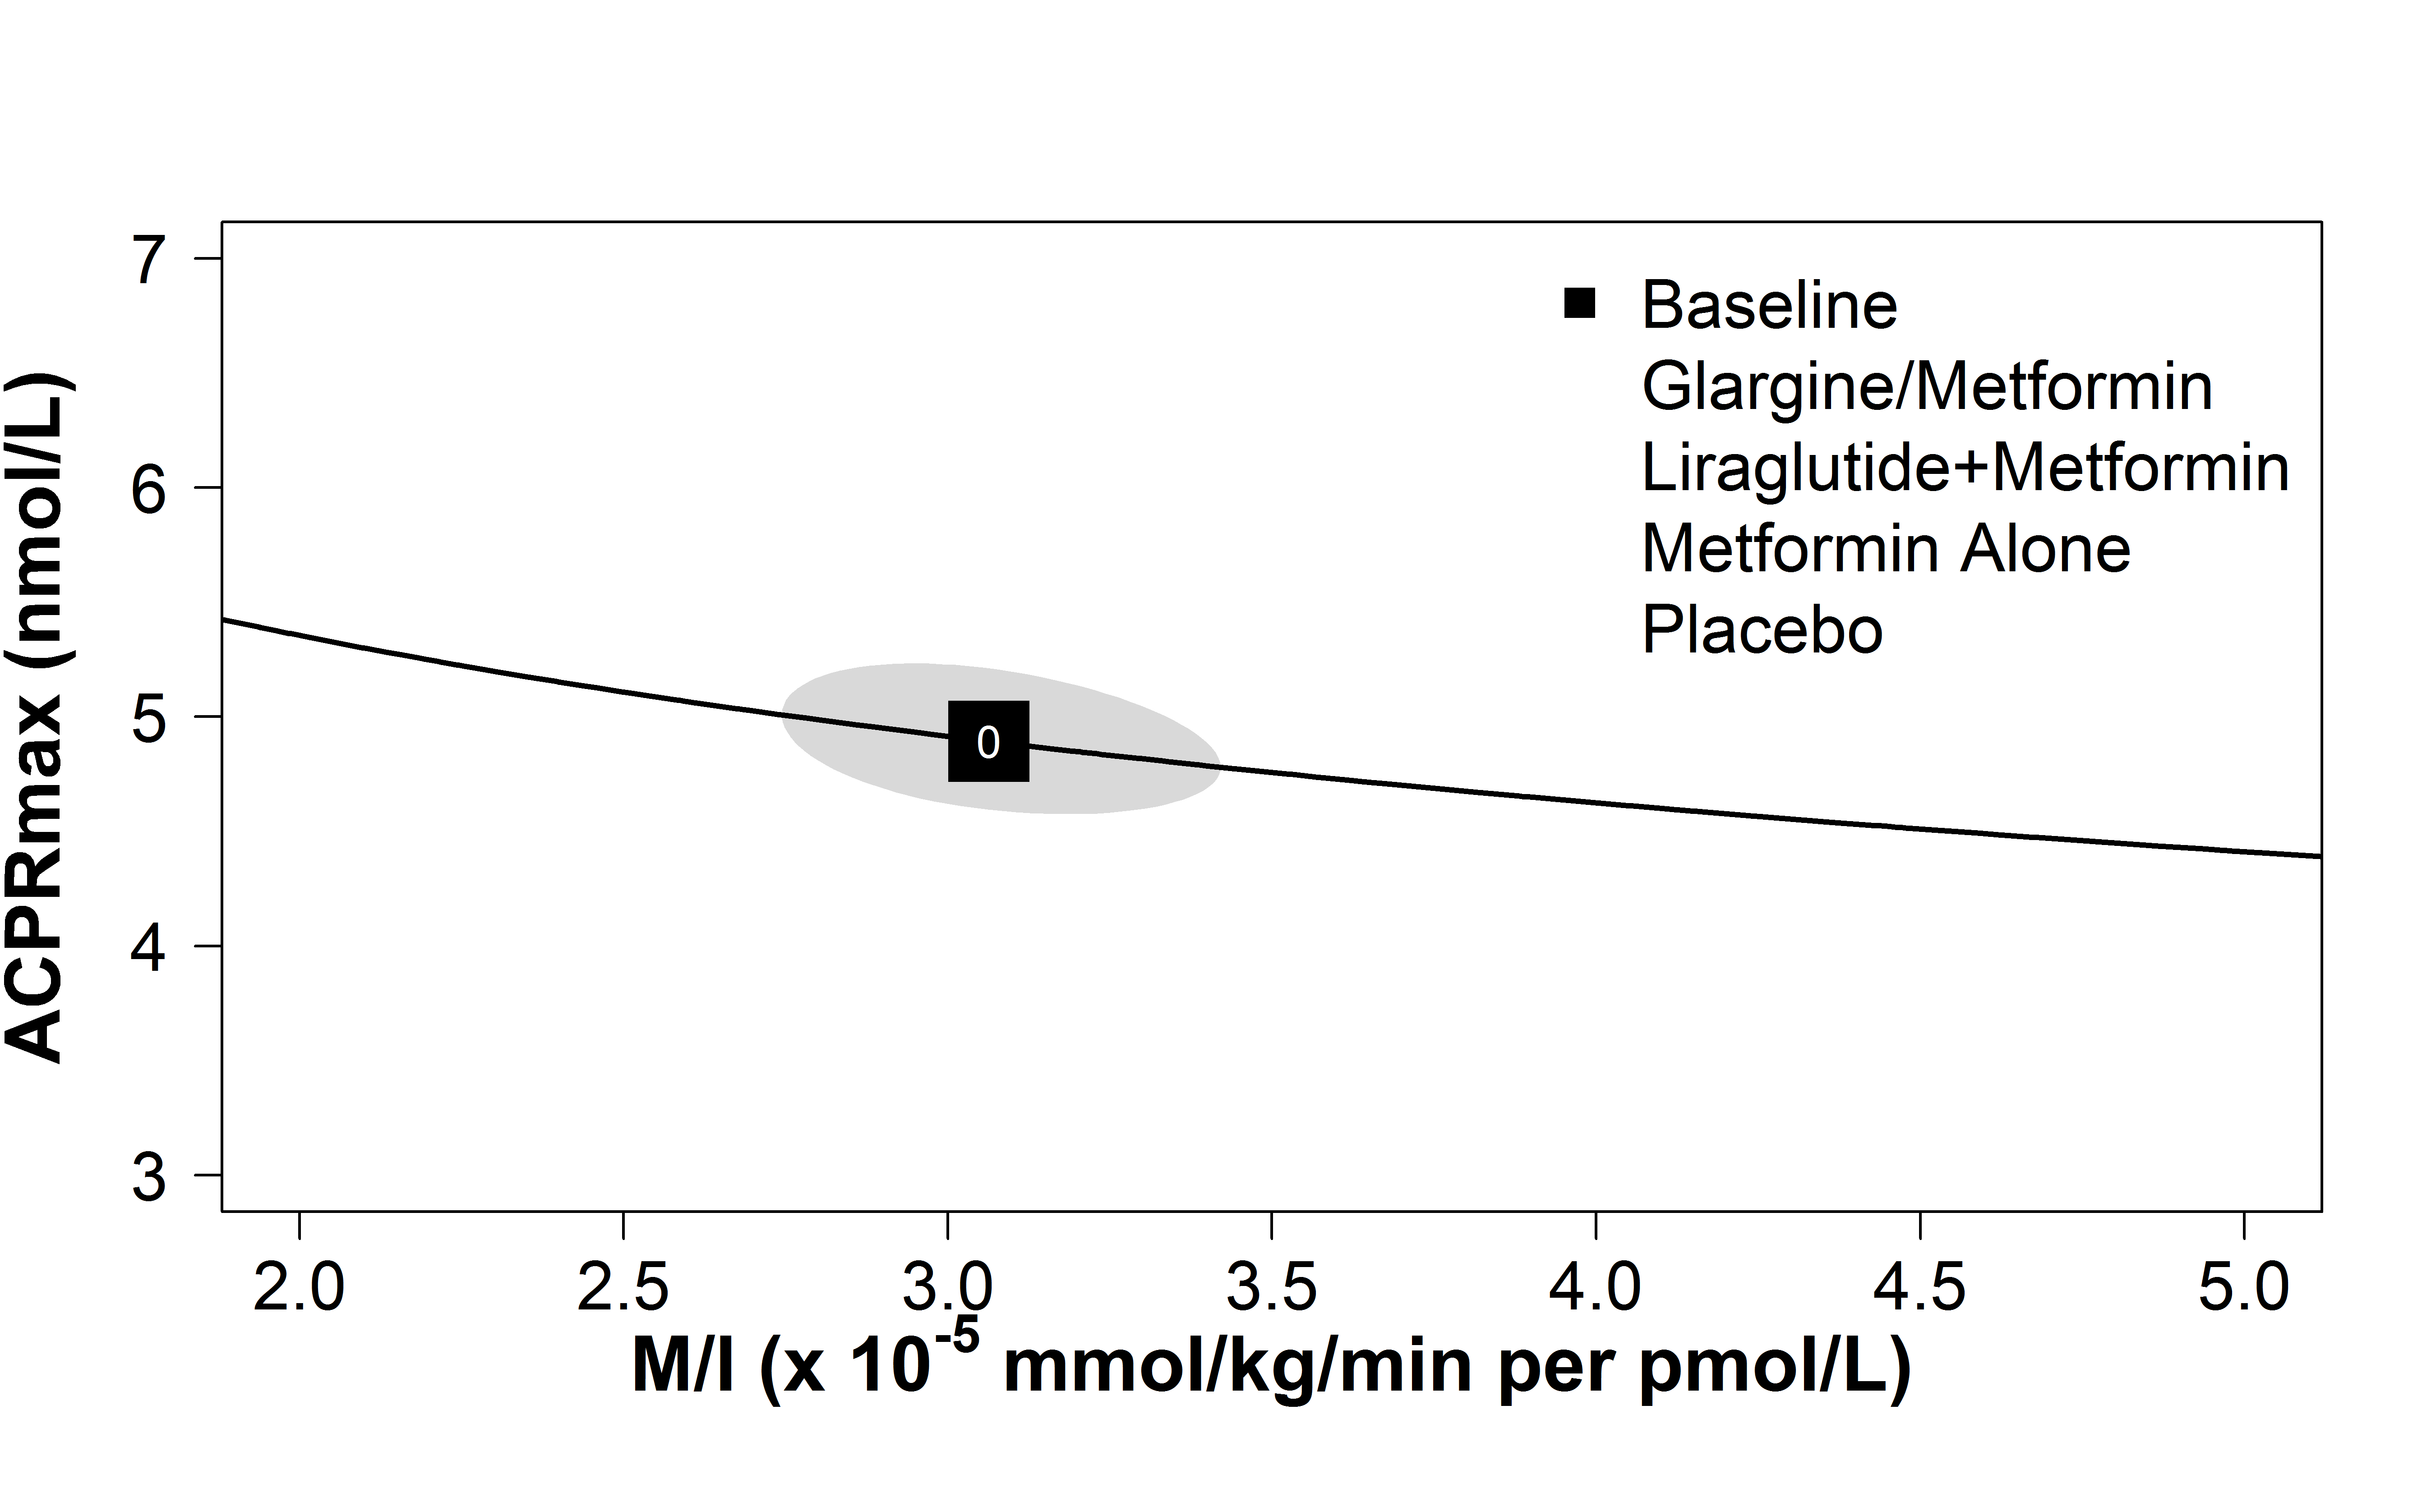
Effects of Study Interventions on β-Cell Function: ACPRmax
The RISE Consortium: Diabetes Care 42(9):1742-1751; 2019

Slide 43
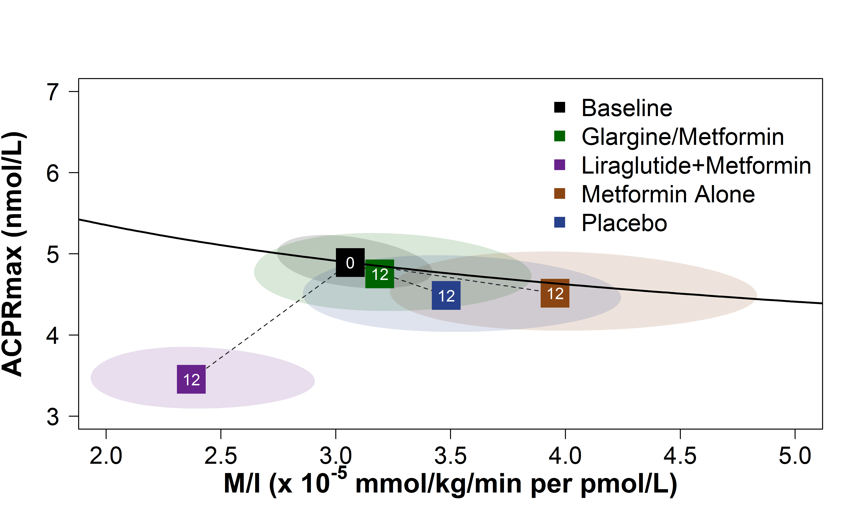
Effects of Study Interventions on β-Cell Function: ACPRmax
The RISE Consortium: Diabetes Care 42(9):1742-1751; 2019

Slide 44
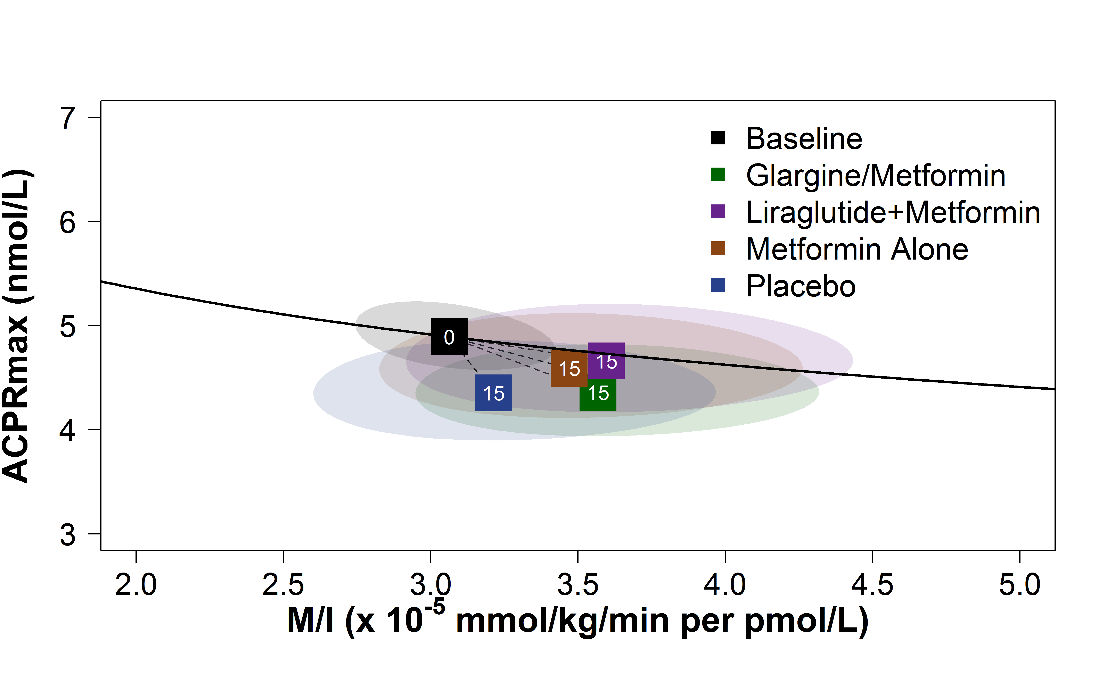
Effects of Study Interventions on β-Cell Function: ACPRmax
The RISE Consortium: Diabetes Care 42(9):1742-1751; 2019

Slide 45
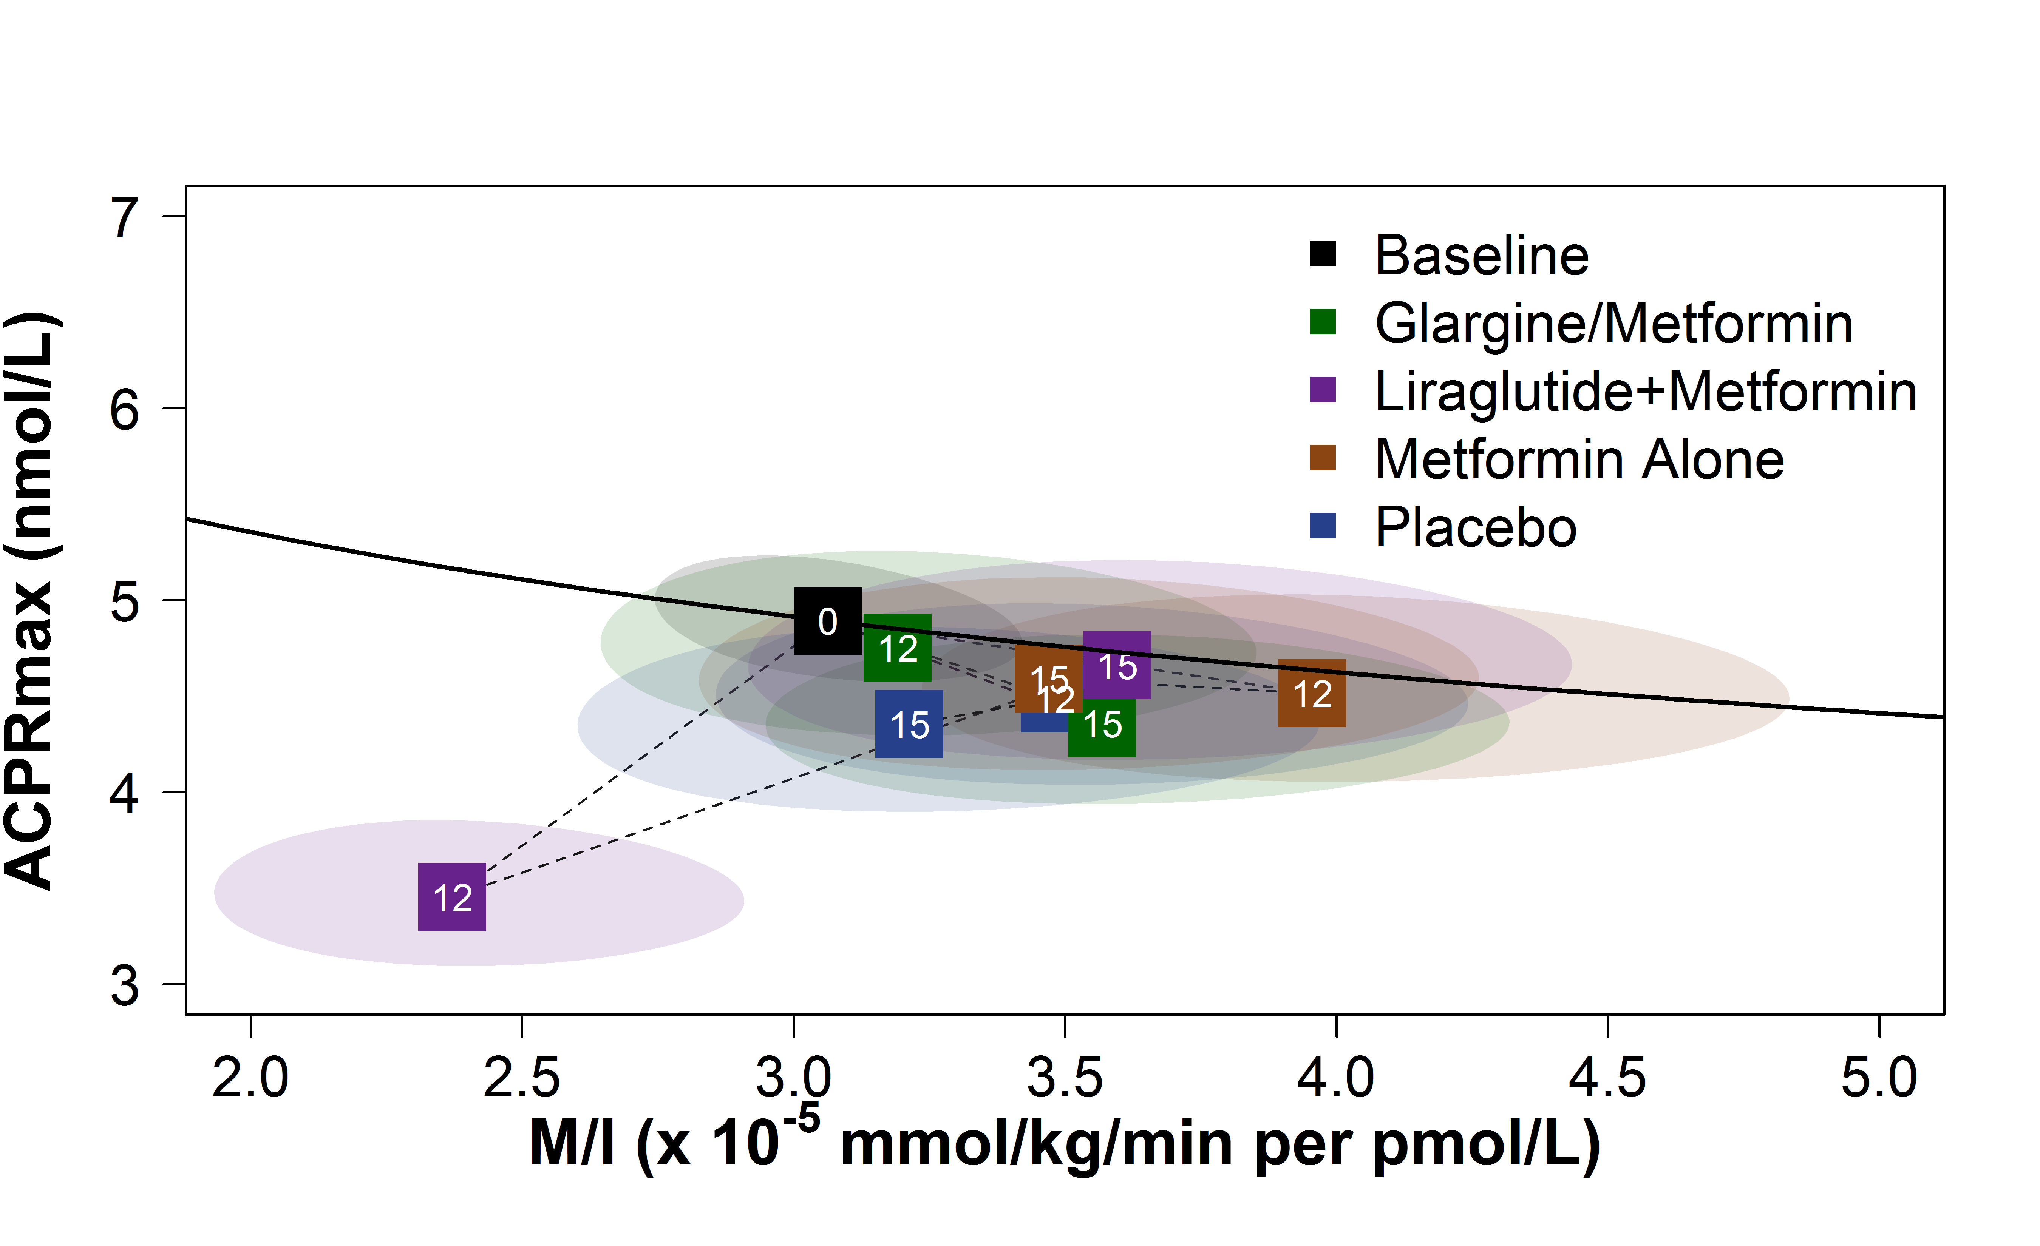
Effects of Study Interventions on β-Cell Function: ACPRmax
The RISE Consortium: Diabetes Care 42(9):1742-1751; 2019

Slide 46
C-peptide Concentrations during Clamp
The RISE Consortium: Diabetes Care 42(9):1742-1751; 2019

Slide 47
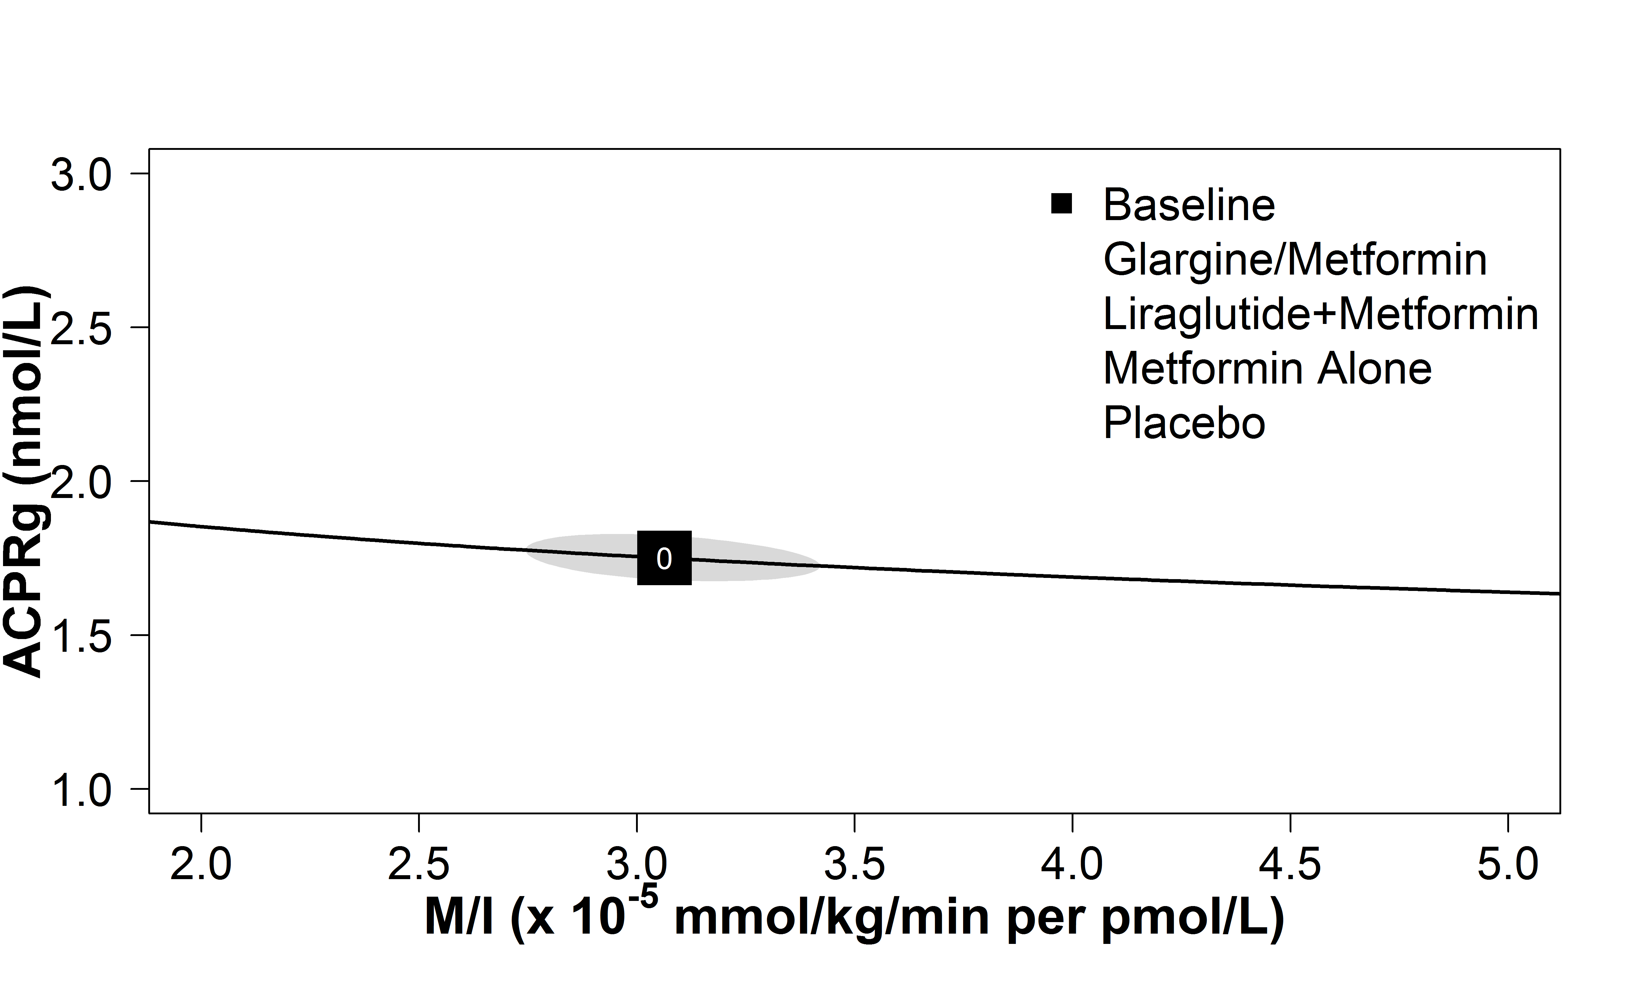
Effects of Study Interventions on β-Cell Function: ACPRg
The RISE Consortium: Diabetes Care 42(9):1742-1751; 2019

Slide 48
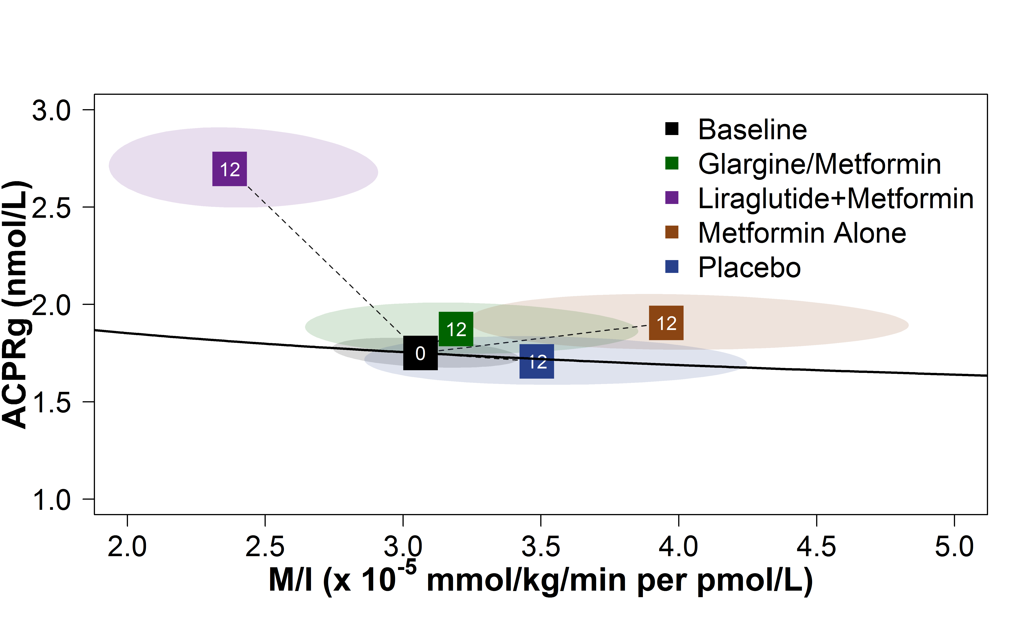
Effects of Study Interventions on β-Cell Function: ACPRg
The RISE Consortium: Diabetes Care 42(9):1742-1751; 2019

Slide 49
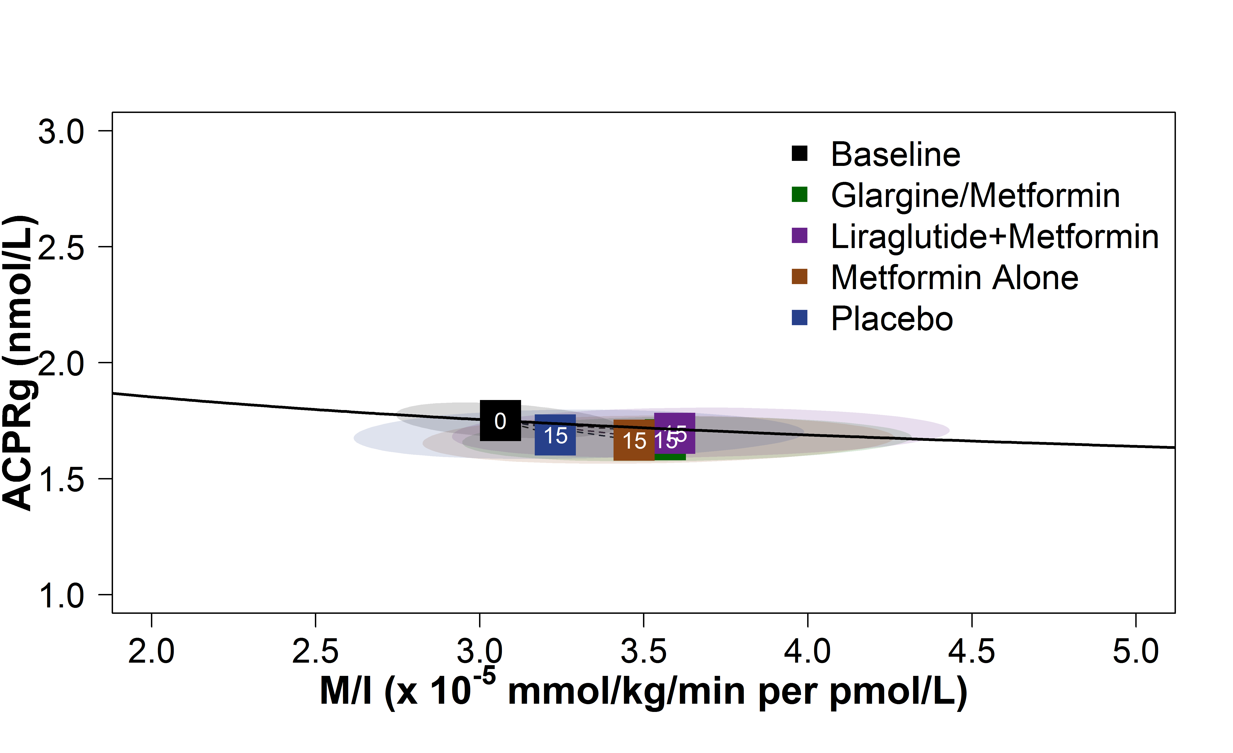
Effects of Study Interventions on β-Cell Function: ACPRg
The RISE Consortium: Diabetes Care 42(9):1742-1751; 2019

Slide 50
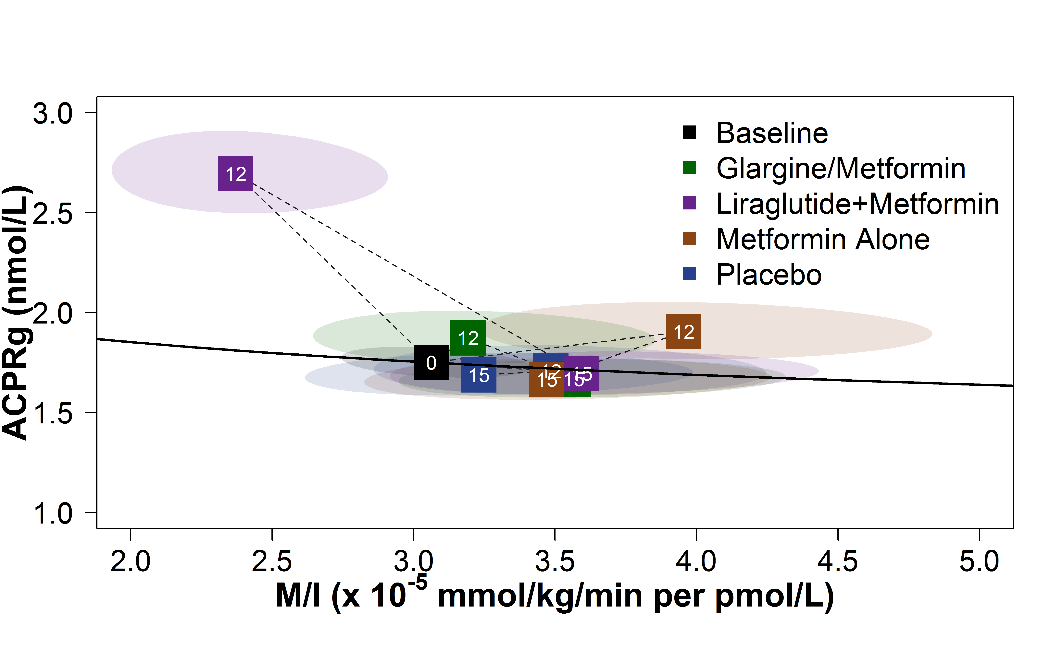
Effects of Study Interventions on β-Cell Function: ACPRg
The RISE Consortium: Diabetes Care 42(9):1742-1751; 2019

Slide 51
Participants with IGT at Baseline
Percent with IGT
Glargine/Metformin: 75%
Liraglutide + Metformin: 72%
Metformin Alone: 75%
Placebo: 73%
The findings in participants with IGT did not differ from the whole cohort.

Slide 52
Summary
After 12 months of treatment, first and second phase C-peptide responses improved in all three active treatment groups, with greatest effects in the Liraglutide + Metformin group.
After 12 months of treatment, the arginine-stimulated C-peptide response at maximal glycemic potentiation (ACPRmax) was reduced in the Liraglutide + Metformin group.
Three months after treatment withdrawal there were no sustained improvements in β-cell function in any treatment group.

Slide 53
Adult Medication Study
Secondary Outcomes

Slide 54
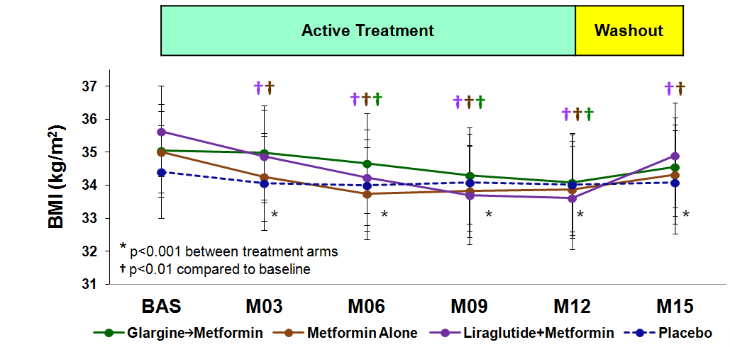
Body Mass Index Over Time
The RISE Consortium: Diabetes Care 42(9):1742-1751; 2019

Slide 55
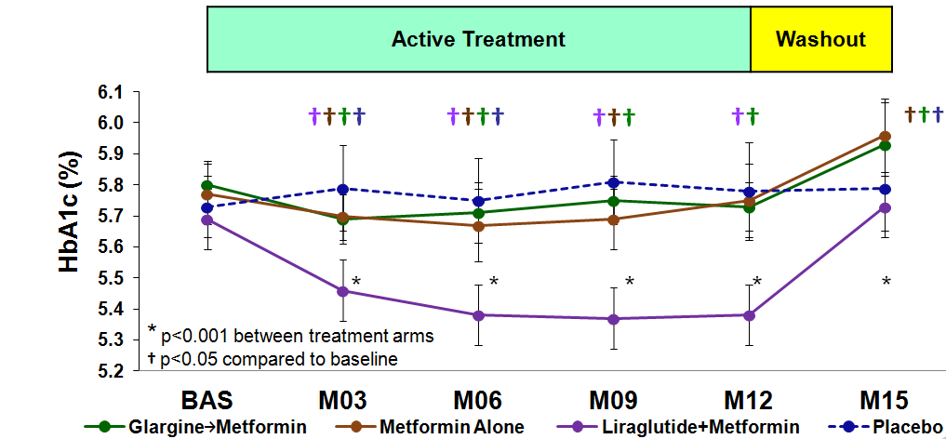
HbA1c Over Time
The RISE Consortium: Diabetes Care 42(9):1742-1751; 2019

Slide 56
Serious and Targeted Adverse Events
Event | Glargine → Met (n=67) | Lira + Met (n=68) | Met Alone (n=65) | Placebo (n=67)
Any low blood sugar | 8 (12%) | 1 (1%) | 3 (5%) | 5 (7%)
Skin rash | 6 (9%) | 1 (1%) | 3 (5%) | 4 (6%)
GI symptoms | 12 (18%) | 28 (41%) | 23 (35%) | 10 (15%)
Diabetes symptoms | 2 (3%) | 0 | 0 | 4 (6%)
Serious adverse events | 3 (4%) | 7 (10%) | 5 (8%) | 3 (4%)
Notes:
SAEs as expected, a blinded adjudication committee determined that none were deemed related to the interventions
Gi symptoms highest in the lira+metformin group and also in the met alone and glar-met groups
Few reports of low blood sugar or of significant diabetes symptoms

Slide 57
Summary
BMI decreased during the active intervention but reverted toward baseline during the washout period.
HbA1c decreased during the active intervention, with the largest decrease in the Liraglutide + Metformin group.
No intervention had a sustained effect on HbA1c. In the Glargine followed by Metformin and Metformin Alone groups, HbA1c at 15 months was greater than baseline.

Slide 58
Adult Medication Study Conclusions
In adults with IGT or recently diagnosed type 2 diabetes, interventions that improved β-cell function during active treatment failed to produce persistent benefits after treatment withdrawal.
These observations suggest that continued intervention may be required to alter the progressive loss of β-cell function in IGT or early type 2 diabetes.

Slide 59
RISE Medication Studies
Adult vs. Youth Comparisons

Slide 60
Mayer-Davis EJ et al: N Engl J Med 376:1419-1429; 2017
Incidence of Type 2 Diabetes in Youth in the USA
Notes:
Figure 2. Kaplan–Meier Estimates of the Cumulative Incidence of Monotherapy Failure at 5 Years. Treatment was considered to have failed if a patient had a confirmed or adjudicated level of fasting plasma glucose of more than 180 mg per deciliter. Risk reduction is listed for comparisons of pairwise groups from a baseline covariate-adjusted Cox proportional-hazards model. Gray's estimates of cumulative incidence adjusted for all deaths were smaller than Kaplan–Meier estimates of treatment failure: 10% in the rosiglitazone group, 15% in the metformin group, and 25% in the glyburide group. I bars indicate 95% CIs.

Slide 61
Interventions for Adult and Youth Medication Arms
 | Adult
Metformin Alone | X
Glargine followed by Metformin | X
Liraglutide + Metformin | X
Placebo | X
RISE Consortium: Diabetes Care 37:780-788; 2014
Notes:
5/14

Slide 62
Interventions for Adult and Youth Medication Arms
 | Adult | Youth
Metformin Alone | X | X
Glargine followed by Metformin | X | X
Liraglutide + Metformin | X
Placebo | X
RISE Consortium: Diabetes Care 37:780-788; 2014
Notes:
5/14

Slide 63
Interventions for Adult and Youth Medication Arms
 | Adult | Youth
Metformin Alone | X | X
Glargine followed by Metformin | X | X
Liraglutide + Metformin | X
Placebo | X
RISE Consortium: Diabetes Care 37:780-788; 2014
Notes:
5/14

Slide 64
Baseline Youth vs. Adults
 | Glargine followed by Metformin |  | Metformin Alone
 | Adult | Youth | Adult | Youth
N | 67 | 44 | 65 | 47
Age (years)* | 54 ± 9 | 15 ± 2 | 55 ± 8 | 14 ± 2
Female, n (%)* | 23 (34%) | 27 (61%) | 37 (57%) | 38 (81%)
Race/Ethnicity, n (%)*
White | 37 (55%) | 13 (30%) | 34 (52%) | 12 (26%)
Black | 21 (31%) | 14 (32%) | 19 (29%) | 9 (19%)
Hispanic (any) | 5 (8%) | 14 (32%) | 6 (9%) | 20 (43%)
Other | 4 (6%) | 3 (7%) | 6 (9%) | 6 (13%)
Weight (kg) | 104 ± 20 | 102 ± 26 | 98 ± 19 | 98 ± 23
BMI (kg/m²) | 35 ± 6 | 37 ± 6 | 35 ± 5 | 37 ± 6
* p<0.001 for treatment group difference
The RISE Consortium: Diabetes 68(8):1670-1680; 2019

Slide 65
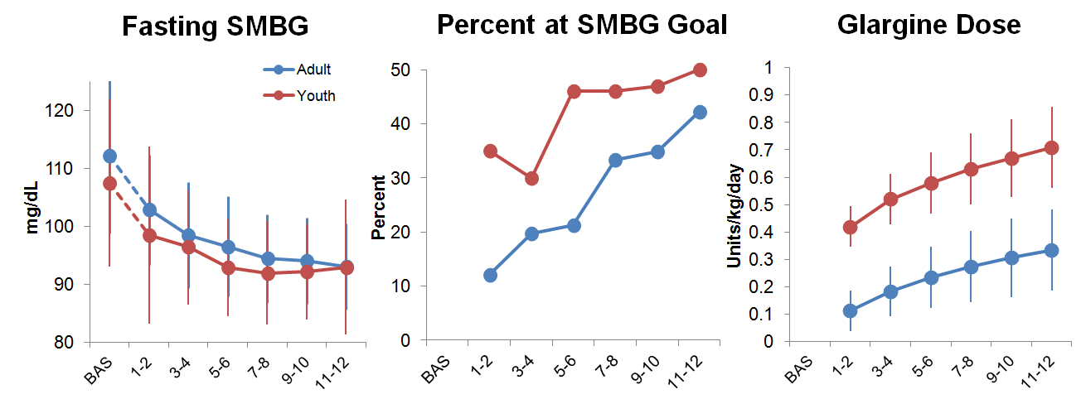
Insulin Doses and Corresponding Fasting Glucose Values: Youth vs. Adults
Weeks
Weeks
Weeks

Slide 66
BMI Change from Baseline
The RISE Consortium: Diabetes 68(8):1670-1680; 2019

Slide 67
HbA1c Change from Baseline
The RISE Consortium: Diabetes 68(8):1670-1680; 2019

Slide 68
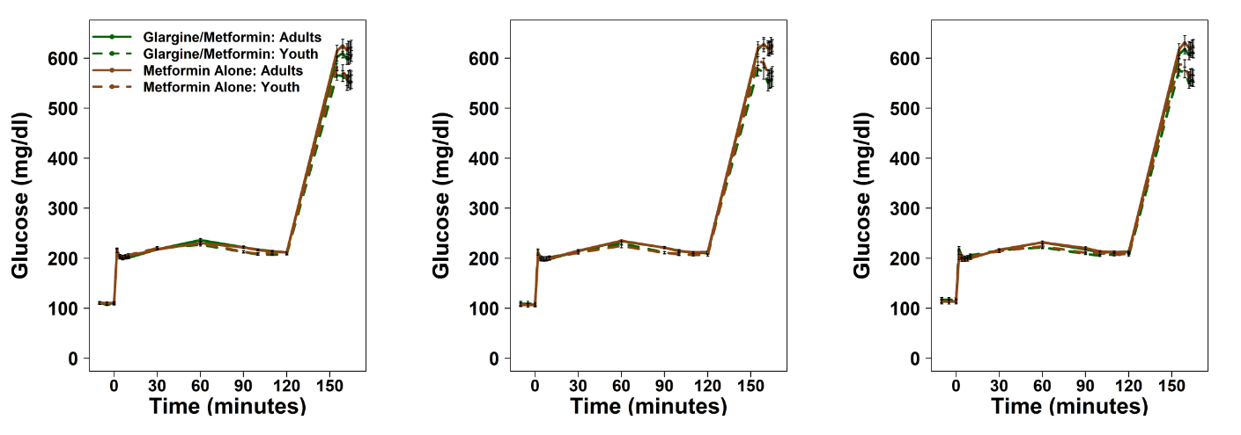
Glucose Concentrations during Clamp Youth vs. Adults
Baseline
Month 12
Month 15
The RISE Consortium: Diabetes 68(8):1670-1680; 2019

Slide 69
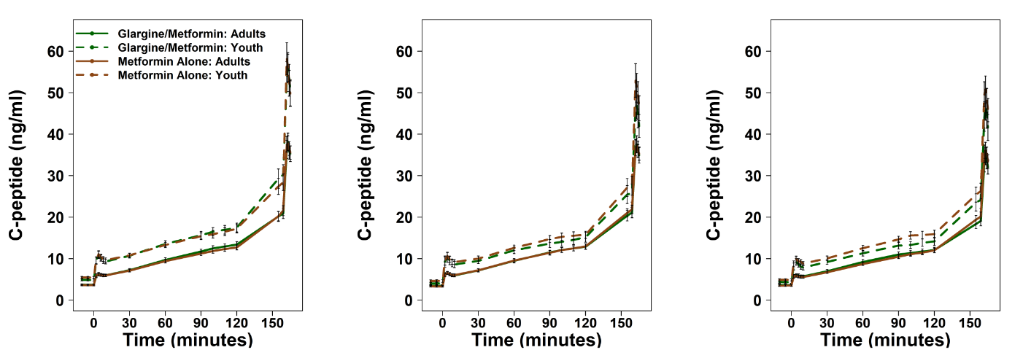
C-peptide Concentrations during Clamp Youth vs. Adults
Baseline
Month 12
Month 15
The RISE Consortium: Diabetes 68(8):1670-1680; 2019

Slide 70
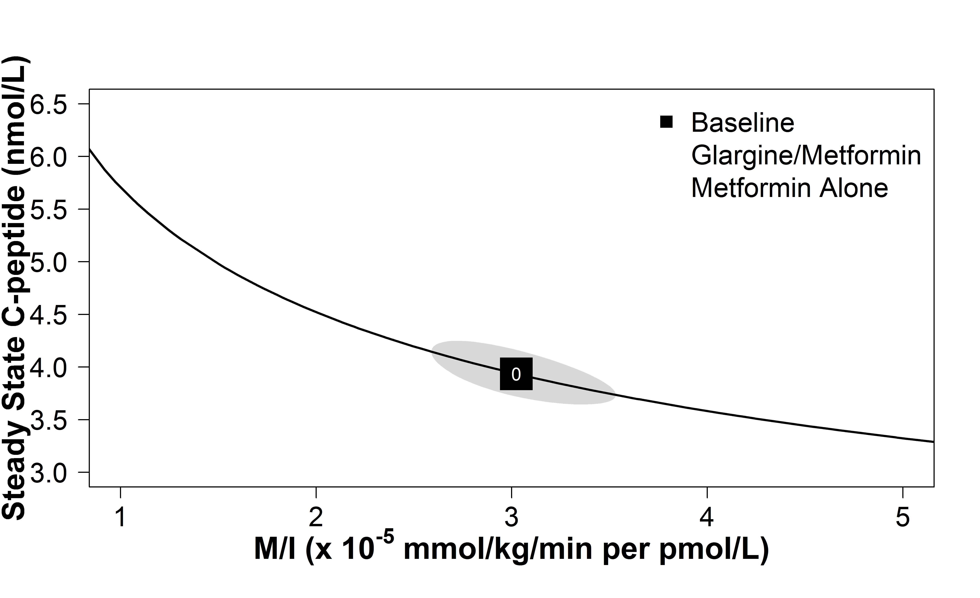
Treatment Effects on Insulin Sensitivity and Steady State C-peptide
Adults
The RISE Consortium: Diabetes 68(8):1670-1680; 2019

Slide 71
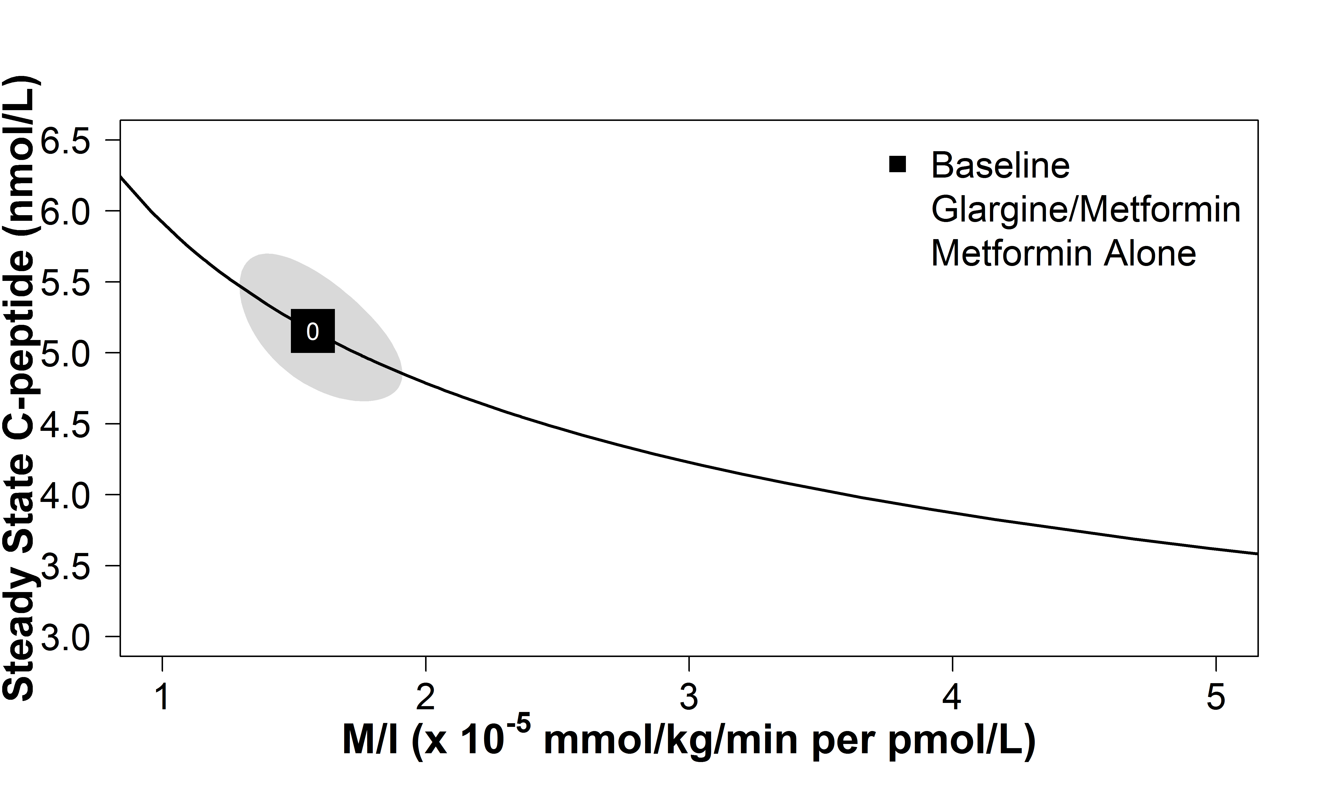
Treatment Effects on Insulin Sensitivity and Steady State C-peptide
Youth
Adults
The RISE Consortium: Diabetes 68(8):1670-1680; 2019

Slide 72
Treatment Effects on Insulin Sensitivity and Steady State C-peptide
Adults
Adults
Youth
The RISE Consortium: Diabetes 68(8):1670-1680; 2019

Slide 73
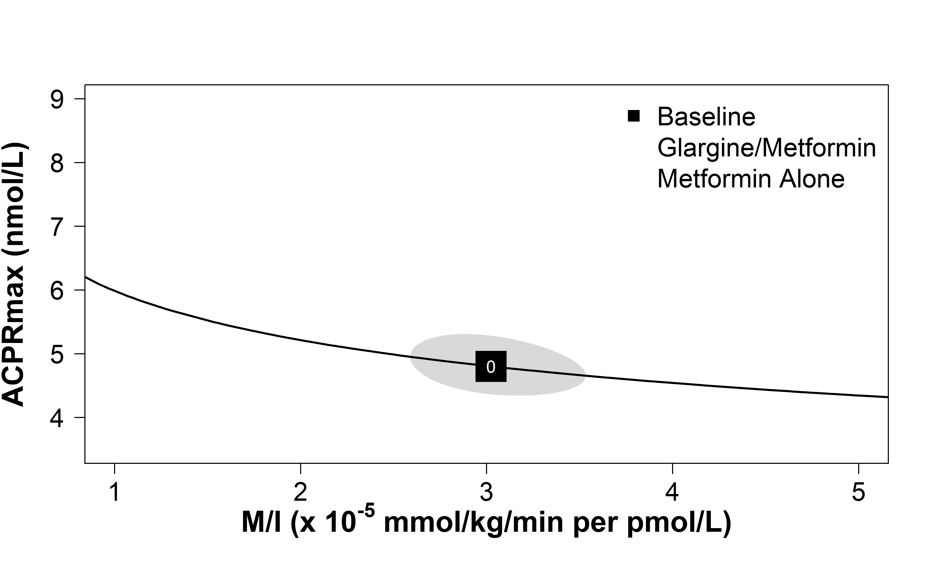
Treatment Effects on Insulin Sensitivity and ACPRmax
Adults
The RISE Consortium: Diabetes 68(8):1670-1680; 2019

Slide 74
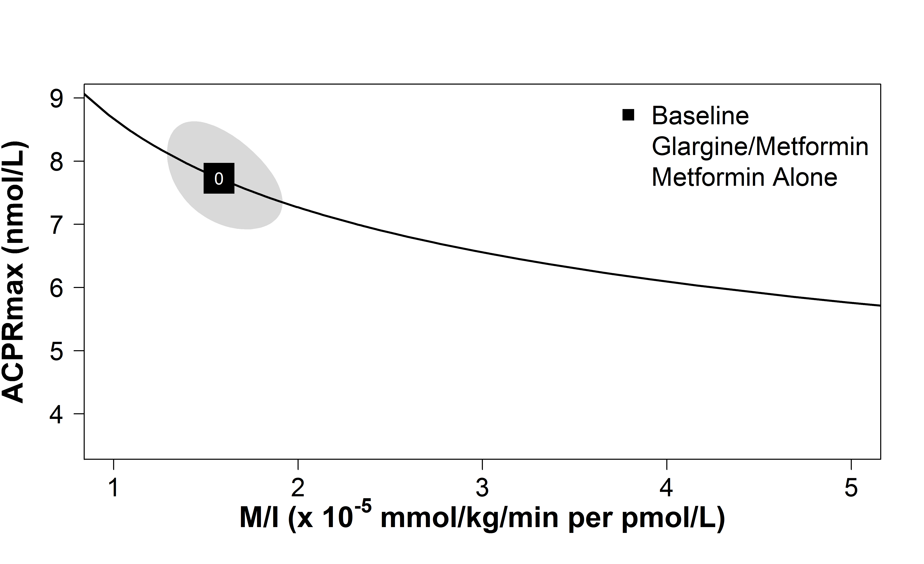
Treatment Effects on Insulin Sensitivity and ACPRmax
Youth
Adults
The RISE Consortium: Diabetes 68(8):1670-1680; 2019

Slide 75
Treatment Effects on Insulin Sensitivity and ACPRmax
Adults
Adults
Youth
The RISE Consortium: Diabetes 68(8):1670-1680; 2019

Slide 76
Treatment Effects on Insulin Sensitivity and ACPRg
Adults
Youth
The RISE Consortium: Diabetes 68(8):1670-1680; 2019

Slide 77
Findings in Adults and Youth with IGT
Percent with IGT
Adults: 75%
Youth: 59%
The findings did not differ in subgroups of adults and youth with IGT.

Slide 78
Summary
Temporal changes in β-cell function were distinctly different in youth compared with adults.
In youth, β-cell function deteriorated during treatment and after treatment withdrawal, with no differences between treatment groups.
In adults, β-cell function improved or remained stable during treatment, but was not sustained after treatment withdrawal.

Slide 79
Conclusions
The difference in β-cell function outcomes in response to medications in youth vs. adults supports a more adverse trajectory of β-cell deterioration in youth.
There is an urgent need to better understand differences in the pathophysiology of type 2 diabetes in youth vs. adults.

Slide 80
Publications
xx-xx
xx-xx
http://care.diabetesjournals.org/collection/rise-consortium

Slide 81
Thanks
@RISEDiabetesStudy
@RISEstudy
rise@bsc.gwu.edu
#RISEstudy
http://care.diabetesjournals.org/collection/rise-consortium

