Slide 1
Restoring Insulin Secretion Study
The RISE Consortium

Slide 2
Is it possible to intervene aggressively to prevent the loss of β-cell function?
Fasting glucose (mg/dL)
<100
100 - 125
≥126
Normal
Impaired
Diabetes
<140
140 - 199
≥200
2-hour glucose (mg/dL)

Slide 3
Background
Study Designs – Pediatric Medication, Adult Medication, and Adult Surgery Protocols

Slide 4
Restoring Insulin Secretion (RISE) Studies
Proof-of-Principle Studies
Comparing medications
Pediatric Medication Study
(10-19 years)
Adult Medication Study
(20-65 years)
Comparing surgical vs. medical intervention
Adult Surgery (BetaFat) Study
(22-65 years)
The RISE Consortium: Diabetes Care 37:780-788; 2014
Notes:
The Restoring Insulin Secretion Study or RISE includes 3 proof of principle randomized clinical trials
(Click) 2 of which are comparing medications, a Pediatric Medication Study in youth ages 10-19 and an Adult Medication Study in adults 20-65 years of age.
(click) and a 3rd study comparing surgical vs. medical intervention known as the Adult Surgery or BetaFat Study in adults ages 22 to 65 years.
(click) Today we will present results from baseline across the 3 studies, comparing adults to children
(click) as well as the results from the Pediatric Medication Study which is now complete. The BetaFat Study will finish participant visits this month, and the Adult Medication Study will be completed next year.

Slide 5
Restoring Insulin Secretion (RISE) Studies
Proof-of-Principle Studies
Comparing medications
Pediatric Medication Study
(10-19 years)
Adult Medication Study
(20-65 years)
Comparing surgical vs. medical intervention
Adult Surgery (BetaFat) Study
(22-65 years)
Primary Results
The RISE Consortium: Diabetes Care 37:780-788; 2014
Notes:
The Restoring Insulin Secretion Study or RISE includes 3 proof of principle randomized clinical trials
(Click) 2 of which are comparing medications, a Pediatric Medication Study in youth ages 10-19 and an Adult Medication Study in adults 20-65 years of age.
(click) and a 3rd study comparing surgical vs. medical intervention known as the Adult Surgery or BetaFat Study in adults ages 22 to 65 years.
(click) Today we will present results from baseline across the 3 studies, comparing adults to children
(click) as well as the results from the Pediatric Medication Study which is now complete. The BetaFat Study will finish participant visits this month, and the Adult Medication Study will be completed next year.

Slide 6
RISE Primary Questions
In participants with impaired glucose tolerance or recently diagnosed type 2 diabetes:
Pediatric and Adult Medication Studies Can β-cell function be preserved or improved during 12 months of active treatment and maintained for 3 months following the withdrawal of therapy?
Adult Surgery Study Can β-cell function be preserved or improved 24 months following laparoscopic banding weight loss surgery?
The RISE Consortium: Diabetes Care 37:780-788; 2014
Notes:
The primary questions asked by RISE are, in participants with impaired glucose tolerance or recently diagnosed type 2 diabetes, in the medication studies is whether beta-cell function can be improved during 12 months of active treatment and then maintained for 3 months following the withdrawal of therapy.
(click) And in the adult surgery study, whether beta-cell function can be improved 24 months following laparoscopic banding weight loss surgery.

Slide 7
Co-Primary Outcomes
Two β-cell response measures from the hyperglycemic clamp, adjusted for insulin sensitivity:
Steady-State C-peptide Response
Mean steady-state C-peptide concentration at glucose ~200 mg/dL (second phase response)
ACPRmax
Arginine-induced acute C-peptide response at maximal glycemic potentiation (glucose >450 mg/dL; β-cell secretory capacity)
The RISE Consortium: Diabetes Care 37:780-788; 2014
Notes:
Two co-primary outcomes were selected which measure different components of ß-cell function.
<enter> The first is the Second phase C-peptide response measured at steady-state of the hyperglycemic clamp at ~200 mg/dl at 100 through 120 minutes of glucose infusion. This is adjusted for insulin sensitivity measured at the same time.
<enter> and the second is ACPRmax, the arginine-induced acute C-peptide response at glucose above 450 mg/dl also adjusted for insulin sensitivity. This is a measure of β-cell secretory capacity.

Slide 8
Inclusion Criteria
Criteria | Pediatric Medication
Age (years) | 10-19
Tanner stage | 2 or above
Body mass index | ≥85th %ile but ≤50 kg/m²
Fasting glucose | ≥90 mg/dL
2-hour OGTT glucose | ≥140 mg/dL
Diabetes duration | <6 months
Diabetes medication status | Metformin <6 months Insulin <2 weeks
HbA1c | ≤8.0% (drug naïve) ≤7.5% (on metformin <3 months) ≤7.0% (on metformin 3-6 months)
Adult Medication | Adult Surgery
20-65 | 22-65
25-50 kg/m² | 30-40 kg/m²
95-125 mg/dL | ≥90 mg/dL
≥140 mg/dL | ≥140 mg/dL
<1 year
Naïve
≤7.0%
Adult Medication | Adult Surgery
The RISE Consortium: Diabetes Care 37:780-788; 2014
Notes:
Adult eligibility criteria was 20 to 65 years of age in the adult medication study and 22 to 65 years in the BetaFat study. The Adult medication study had a BMI requirement of 25 to 50 kg/m². The BMI eligibility was more stringent in the adult surgery study based on device requirements and was 30 to 40 kg/m². Fasting glucose criteria for the adult medication study was restricted to 95-125 mg/dl and was at least 90 mg/dl in the BetaFat study. For both adult studies, participants must have had a 2 hour OGTT glucose of 140 mg/dl or greater., diabetes duration must be less than 1 year with participants drug naïve to diabetes medications, and HbA1c was required to be less than or equal to 7%.

Slide 9
Randomized Study Interventions
Pediatric Medication | Adult Medication | Adult Surgery
Metformin | Metformin (blinded) | Metformin
Glargine → Metformin | Glargine → Metformin | Laparoscopic banding
 | Liraglutide + Metformin
 | Placebo (blinded)
The RISE Consortium: Diabetes Care 37:780-788; 2014
Notes:
Importantly, the metformin intervention is identical in the three trials, allowing comparisons in similar participants across the age span.

Slide 10
Randomized Study Interventions
Pediatric Medication | Adult Medication | Adult Surgery
Metformin | Metformin (blinded) | Metformin
Glargine → Metformin | Glargine → Metformin | Laparoscopic banding
 | Liraglutide + Metformin
 | Placebo (blinded)
The RISE Consortium: Diabetes Care 37:780-788; 2014
Notes:
Similarly, the Glargine followed by Metformin arm in the pediatric and adult medication studies was identical.

Slide 11
Medication Study Protocols: Study Phases and Key Time Points
Hyperglycemic Clamp
OGTT
Primary Outcome Collection
Hyperglycemic Clamp
OGTT
Screening
Run-in (3 weeks)
Active Treatment (12 months)
Washout (3 months)
Baseline
Randomization
12 months
15 months
The RISE Consortium: Diabetes Care 37:780-788; 2014
Notes:
(click) This post-washout visit represents the primary outcome for the RISE Medication Studies.

Slide 12
Adult Surgery Protocol: Study Phases and Key Time Points
Hyperglycemic Clamp
OGTT
Hyperglycemic Clamp
OGTT
Primary Outcome Collection
Hyperglycemic Clamp
OGTT
Screening
Active Treatment (24 months)
Baseline
Randomization
12 months
24 months
The RISE Consortium: Diabetes Care 37:780-788; 2014
Notes:
<enter> which represents the primary outcome collection for the BetaFat trial

Slide 13
Timing of Metabolic Testing: Comparisons Between Protocols
 |  | Baseline (prior to Rx) | 12 months (on Rx) | 15 months (3 months off Rx) | 24 months (on Rx)
Pediatric Medication | Clamp | X | X | X
 | OGTT | X | X | X
Adult Medication | Clamp | X | X | X
 | OGTT | X | X | X
Adult Surgery | Clamp | X | X |  | X
 | OGTT | X | X |  | X
The RISE Consortium: Diabetes Care 37:780-788; 2014
Notes:
Thus, all 3 studies have both a baseline pre-treatment hyperglycemic clamp and OGTT, which were repeated 1 year following active treatment. However the medication studies have their primary outcome clamp and OGTT following 3 months of washout, while the surgery study followed participants on active treatment for a full 2 years.
(click) Today’s presentations will focus on the baseline hyperglycemic clamp and OGTT data from all 3 studies
(click) and the pediatric primary outcome results from the hyperglycemic clamp

Slide 14
Power and Sample Size Considerations
β-cell function co-primary outcomes (steady-state C-peptide and ACPRmax) analyzed separately each with a type I error of α=0.05
Power set at 80%
Pediatric Medication Study only: powered using a 1-sided type I error of α=0.05 in favor of the glargine followed by metformin intervention
The RISE Consortium: Diabetes Care 37:780-788; 2014
Notes:
The 2 outcomes were powered separately to be analyzed each with a type 1 error set at 0.05,
(click) and power set at 80%.
(click) The pediatric medication study was powered using a 1-sided test in favor of the glargine followed by metformin intervention.

Slide 15
Sample Size
 | Pediatric Medication | Adult Medication | Adult Surgery
Sample size | 39 per arm (78 total) | 56 per arm (224 total) | 35 per arm (70 total)
Expected loss to followup | 10% | 10% | 20%
Recruitment goal | 90 | 255 | 88
Randomized | 91 | 267 | 88
Final primary outcome visit | July 2017 | January 2019 | June 2018
The RISE Consortium: Diabetes Care 37:780-788; 2014
Notes:
There was little data to help estimate the effect sizes we might observe, so based on our best estimates of beta cell function and meaningful differences between treatment groups, the goal for the pediatric medication study was 78 children, was 224 adults in the adult medication study, and 70 adults for the BetaFat surgery study. Allowing for a 10% expected loss to followup in the medication studies and 20% in the surgery study, the recruitment goals were 90, 255 and 88 participants. All studies have now finished recruitment, and we slightly over-randomized to the adult medication study. The pediatric medication study is complete, and the BetaFat surgery study will finish this month. The final outcome visits for the adult medication study will take place next year.
(click) I’d now like to introduce my colleague Dr. Kieren Mather, a professor of medicine at the Indiana University school of medicine, who will describe for you the baseline characteristics of the sample.

Slide 16
Baseline Data Comparing Youth and Adults
Contrasts in Beta-cell Function Based on the Hyperglycemic Clamp and OGTT

Slide 17
Objective
To compare insulin sensitivity and β-cell responses in youth vs. adults with impaired glucose tolerance or drug-naïve, recently diagnosed type 2 diabetes using:
Hyperglycemic clamp
Oral glucose tolerance test (OGTT)

Slide 18
Two-step Hyperglycemic Clamp Protocol
β-cell Responses
Acute C-peptide
Response to
Arginine (ACPR_{max})
Arginine
bolus
Steady-state
C-peptide
Acute C-peptide
Response to
Glucose (ACPR_{g})
.
Glucose
bolus
.
Glucose
bolus
.
.
.
.
The RISE Consortium: Diabetes Care 37:780-788; 2014
Notes:
1/18

Slide 19
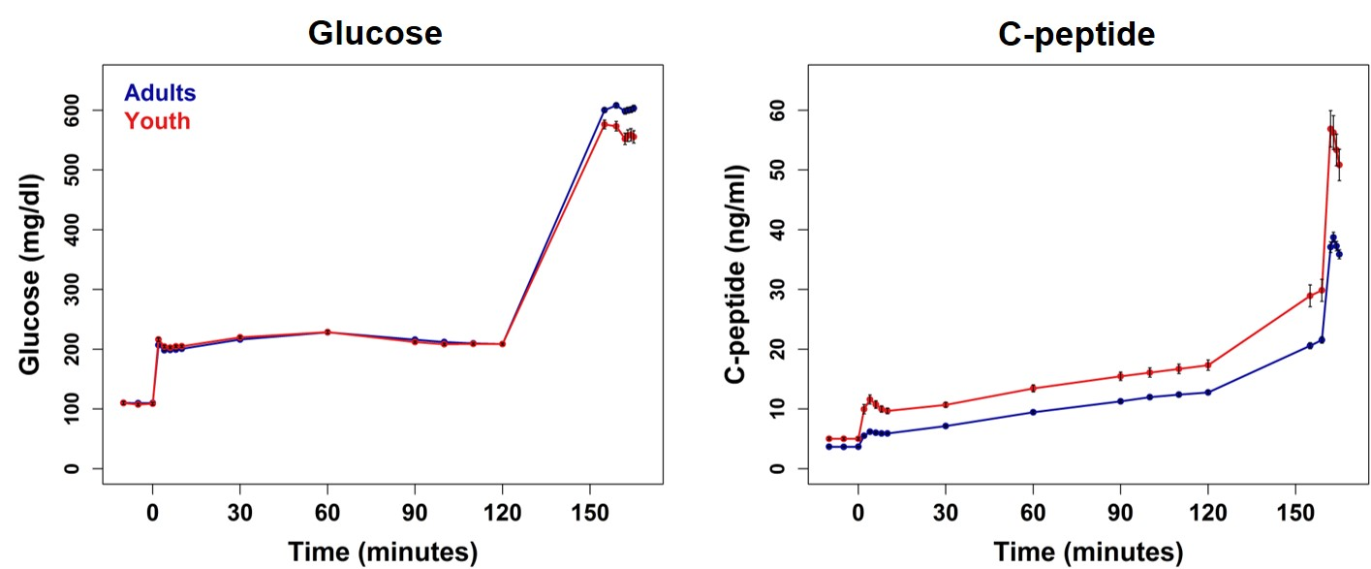
Clamp-Glucose and C-Peptide Profiles in Youth vs. Adults
Glucose
C-peptide
The RISE Consortium: Diabetes Care 41:1696-1706; 2018

Slide 20
C-Peptide Responses in Youth vs. Adults
ACPRg
Steady State C-Peptide
ACPRmax
p<0.001
p<0.001
p<0.001
ACPRmax (ng/mL)
ACPRg (ng/mL)
Steady-state C-peptide (ng/mL)
Youth Adults
Youth Adults
Youth Adults
Adapted from The RISE Consortium: Diabetes Care 41:1696-1706; 2018

Slide 21
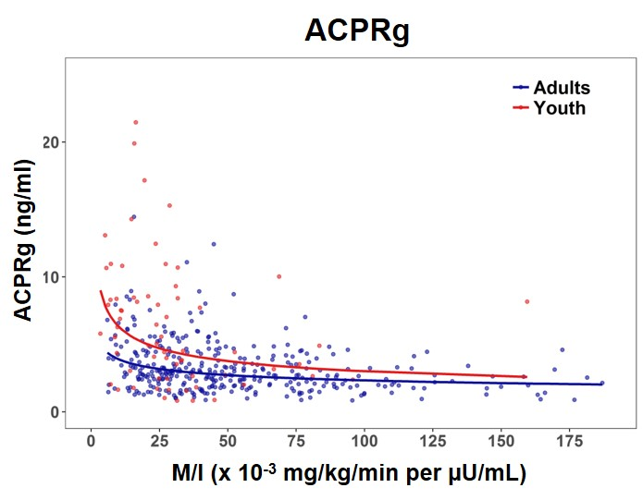
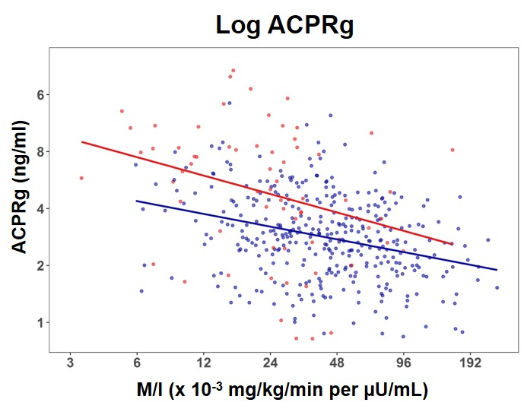
Relationship of Insulin Sensitivity with the Acute C-peptide Response to Glucose in Youth and Adults
Log ACPRg
ACPRg (ng/ml)
M/I (x 10⁻³ mg/kg/min per µU/mL)
Slope p<0.001 Group * Slope p=ns
The RISE Consortium: Diabetes Care 41:1696-1706; 2018

Slide 22
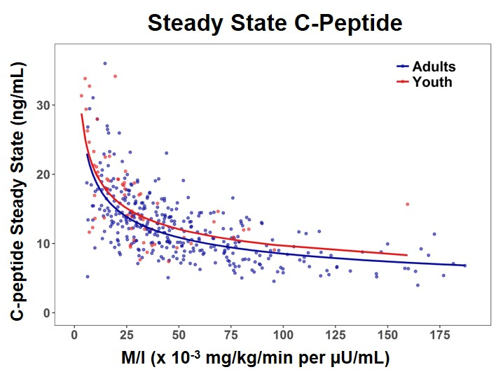
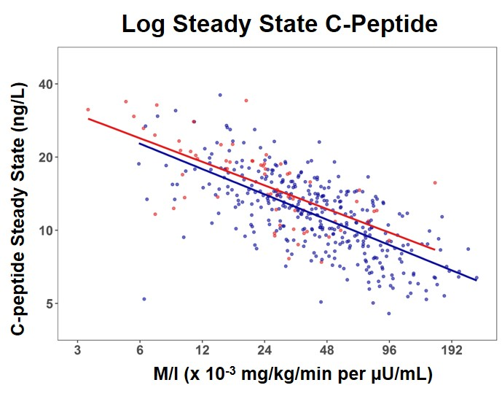
Relationship of Insulin Sensitivity with Steady-State C-peptide in Youth and Adults
Slope p<0.001 Group * Slope p=ns
The RISE Consortium: Diabetes Care 41:1696-1706; 2018

Slide 23
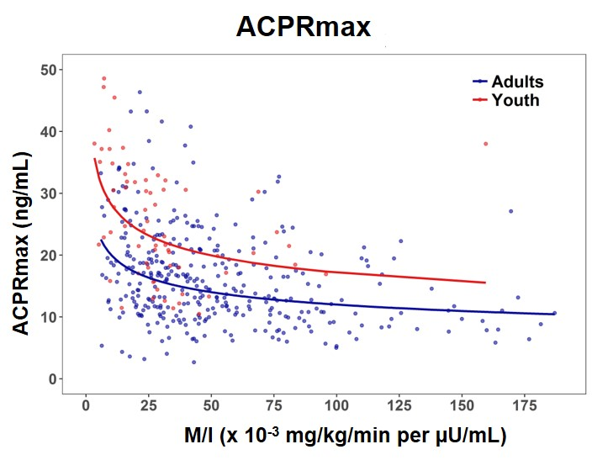
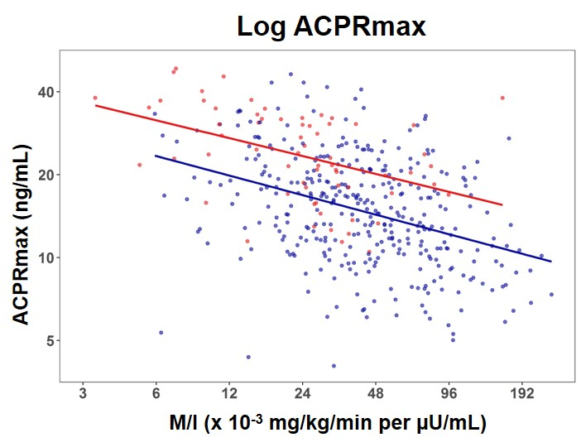
Relationship of Insulin Sensitivity with the Acute C-peptide Response to Arginine in Youth and Adults
ACPRmax
ACPRmax (ng/mL)
M/I (x 10⁻³ mg/kg/min per µU/mL)
Slope p<0.001 Group * Slope p=ns
The RISE Consortium: Diabetes Care 41:1696-1706; 2018

Slide 24
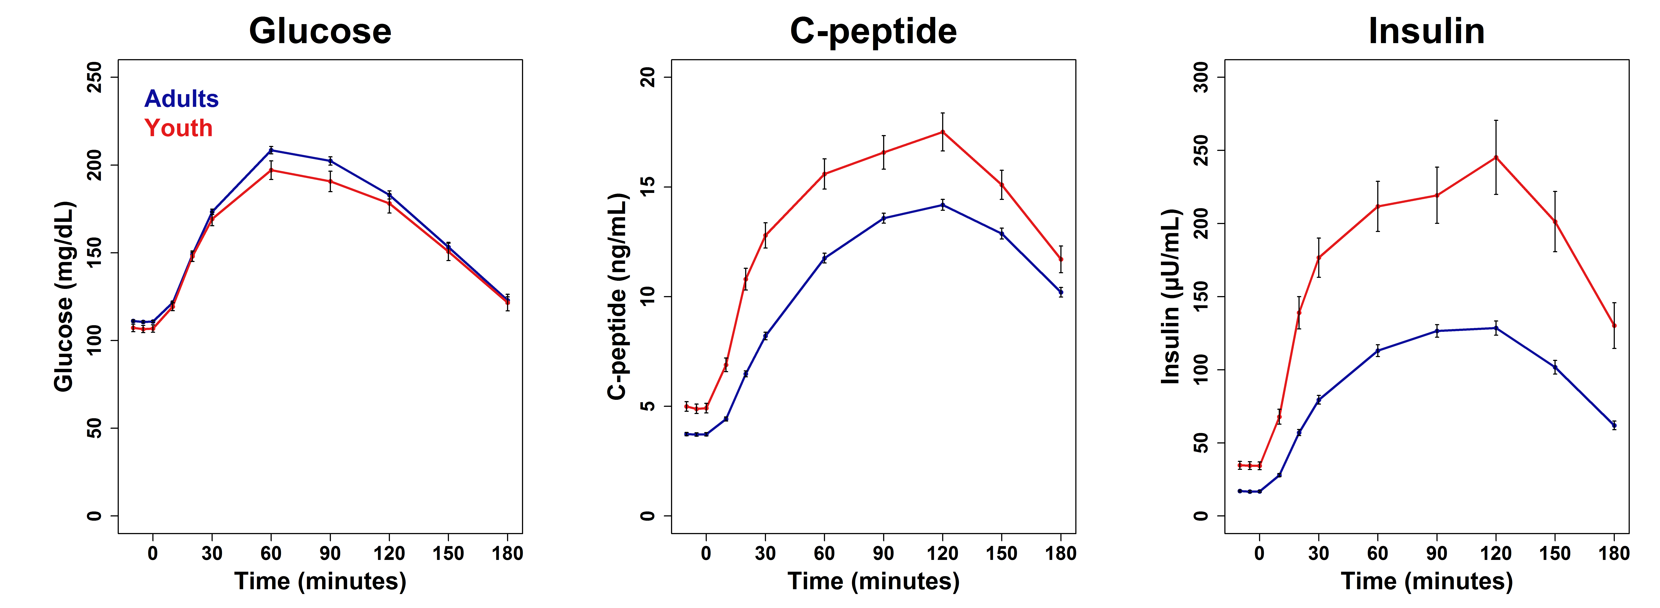
OGTT Glucose, C-peptide and Insulin Profiles in Youth vs. Adults
Glucose C-peptide Insulin
The RISE Consortium: Diabetes Care 41:1707-1716; 2018

Slide 25
OGTT-Derived Measurements
Insulin sensitivity: 1/fasting insulin (1/FI)
Early C-peptide response: [∆C₍₃₀₋₀₎/∆G₍₃₀₋₀₎]
The RISE Consortium: Diabetes Care 41:1707-1716; 2018

Slide 26
OGTT-Derived Insulin Sensitivity and Early C-peptide Response in Youth vs. Adults
Insulin Sensitivity
Early C-peptide Response
p<0.001
p<0.001
1/Fasting Insulin (1/mu/mL)
Early C-peptide Response (ng/ml)
Youth Adults
Youth Adults
Adapted from The RISE Consortium: Diabetes Care 41:1707-1716; 2018

Slide 27
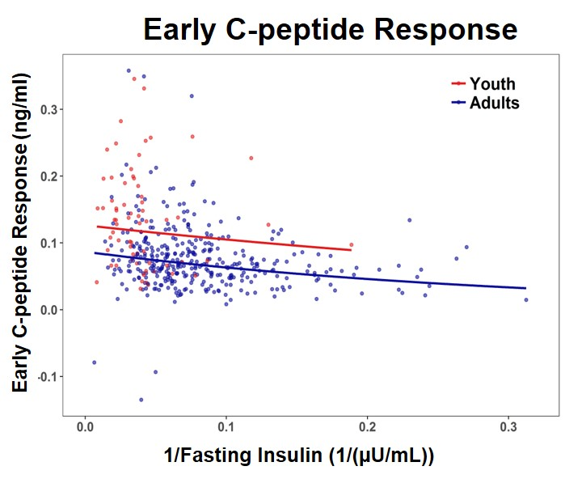
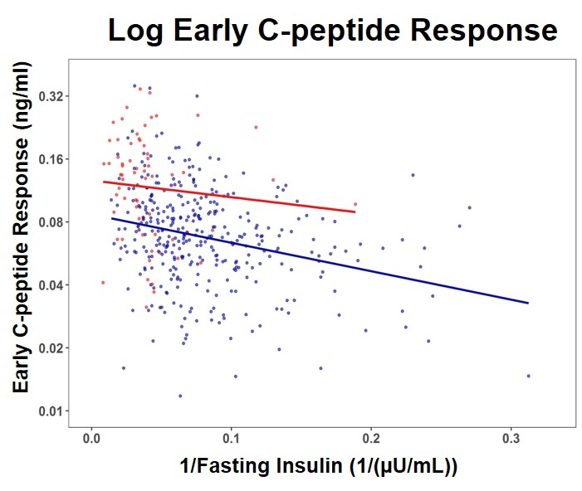
Relationship of 1/Fasting Insulin and Early C-peptide Response in Youth and Adults
Log Early C-peptide Response
Early C-peptide Response (ng/ml)
1/Fasting Insulin (1/(µU/mL))
Slope p<0.001 Group * Slope p=ns
The RISE Consortium: Diabetes Care 41:1707-1716; 2018

Slide 28
Summary: Youth vs. Adults
Insulin sensitivity was ~50% lower in youth than comparably overweight dysglycemic adults.
Acute C-peptide responses to intravenous glucose and non-glucose secretagogue arginine were greater in youth.
Similarly, after oral glucose ingestion, C-peptide and insulin responses were greater in youth despite similar glucose excursions.
These compensatory responses for the lower insulin sensitivity were proportionately greater in youth than adults.

Slide 29
Conclusions
At all levels of insulin sensitivity, youth in RISE have hyperresponsive β-cells; this may represent a fundamental difference in the pathogenesis of type 2 diabetes between youth and adults.
This difference may explain the different rates at which diabetes develops and progresses in youth and adults.

Slide 30
RISE Pediatric Medication Study
Comparisons of Baseline Data by Intervention Arms

Slide 31
RISE Pediatric Medication Study Question
In youth with IGT or recently diagnosed type 2 diabetes, can β-cell function be preserved or improved during 12 months of pharmacologic intervention, and maintained for 3 months following the withdrawal of therapy?

Slide 32
Rationale for Use of Metformin
Metformin and insulin are the only medications approved for treating type 2 diabetes in youth.
In adults with IGT or recently diagnosed type 2 diabetes, metformin slows progression of dysglycemia by improving β-cell function.
Diabetes Prevention Program Research Group: Diabetes 54:2404-14; 2005
ADOPT Study Group: Diabetes 60:1552-60; 2011

Slide 33
Study Interventions
Randomized, unblinded, proof-of-principle trial comparing two treatment regimens:
Glargine followed by metformin
3 months of insulin glargine alone, titrated to fasting self-monitored blood glucose (SMBG) of 80-90 mg/dL
9 months of metformin alone, titrated to 1,000 mg twice daily
Metformin only
12 months of metformin, titrated to 1,000 mg twice daily
The RISE Consortium: Diabetes Care 37:780-788; 2014

Slide 34
Inclusion Criteria
Criteria | Eligibility
Age | 10-19 years
Tanner stage | ≥2
BMI | ≥85th %ile but ≤50 kg/m²
Diabetes duration | <6 months
Diabetes medication status | Metformin <6 months; Insulin <2 weeks
Fasting plasma glucose | ≥90 mg/dL
2-hour OGTT glucose | ≥140 mg/dL
HbA1c | ≤8.0% (drug naïve) ≤7.5% (on metformin <3 months) ≤7.0% (on metformin 3-6 months)
Autoantibodies | Negative IA-2, GAD

Slide 35
Baseline Characteristics
Criteria | Glargine followed by metformin (n=44) | Metformin alone (n=47)
Female | 27 (61%) | 38 (81%)
Age (years) | 14.9 ± 2.0 | 13.9 ± 2.1*
Tanner Stage 5 | 72% | 53%
White | 13 (29%) | 12 (25%)
Black | 14 (32%) | 9 (19%)
Hispanic | 14 (32%) | 20 (43%)
Diagnosis of diabetes | 18 (41%) | 19 (40%)
* p=0.03 for group difference
The RISE Consortium: Diabetes Care 41:1717-1725; 2018

Slide 36
Baseline Characteristics
Criteria | Glargine followed by metformin (n=44) | Metformin alone (n=47)
Weight (kg) | 102.0 ± 25.7 | 97.7 ± 23.3
BMI (kg/m²) | 36.5 ± 6.4 | 36.9 ± 6.4
BMI percentile | 98.4 ± 2.5 | 98.8 ± 1.3
Systolic BP (mm Hg) | 120.7 ± 7.8 | 119.5 ± 8.7
Diastolic BP (mm Hg) | 67.6 ± 7.7 | 70.1 ± 7.9
Hypertension (n, %) | 9 (20.5%) | 15 (31.9%)
LDL (mg/dL) | 87.1 ± 31 | 80.3 ± 24.4
HDL (mg/dL) | 39.5 ± 9.8 | 40.2 ± 8
Triglycerides (mg/dL) | 98.5 (34.8, 278.4) | 103.6 (39.6, 271.2)

Slide 37
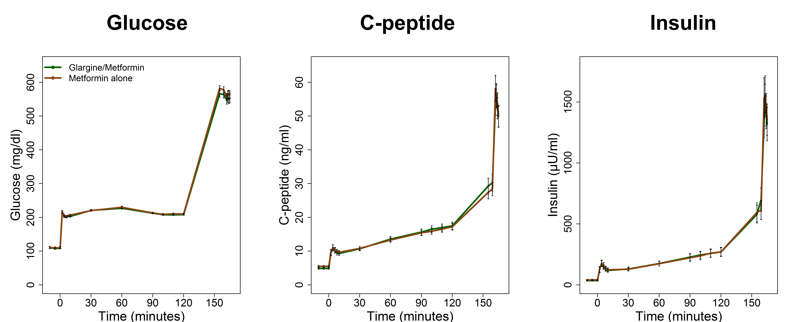
Baseline Glucose, C-peptide and Insulin Profiles
Glucose C-peptide Insulin
The RISE Consortium: Diabetes Care 41:1717-1725; 2018

Slide 38
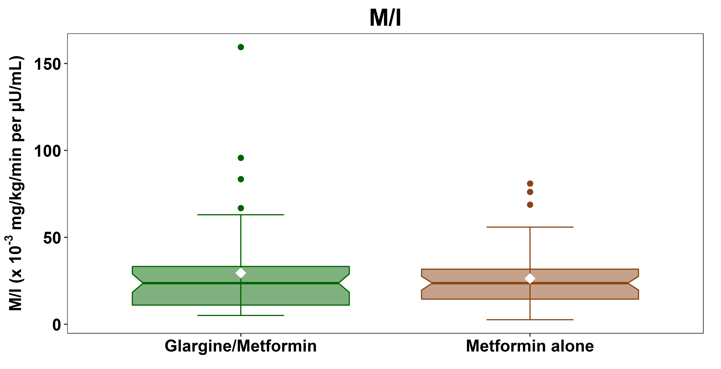
Baseline Hyperglycemic Clamp Results: Insulin Sensitivity (M/I)
The RISE Consortium: Diabetes Care 41:1717-1725; 2018

Slide 39
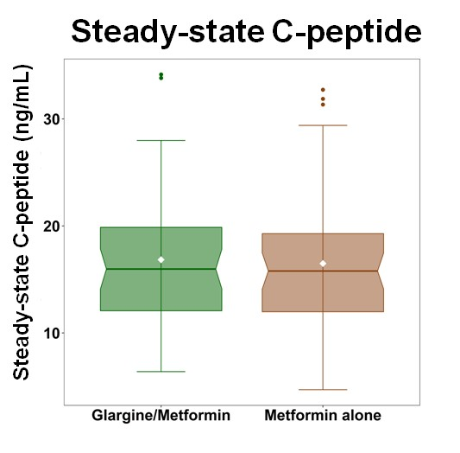
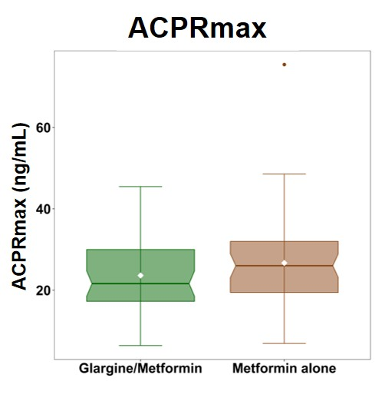
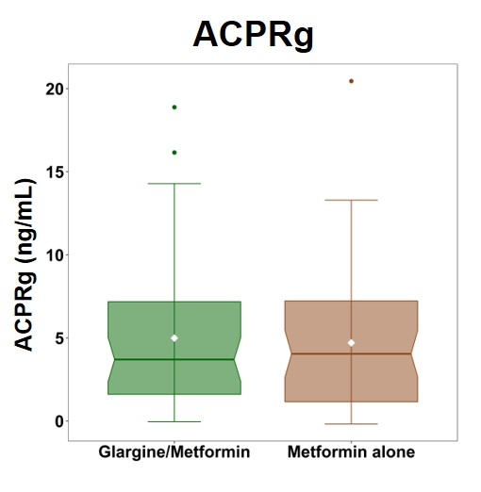
Baseline Hyperglycemic Clamp Results: β-cell Response Measures
The RISE Consortium: Diabetes Care 41:1717-1725; 2018

Slide 40
Summary
In this cohort of youth with impaired glucose tolerance or recently diagnosed type 2 diabetes, the two intervention groups were well matched at baseline.

Slide 41
RISE Pediatric Medication Study
Primary Outcomes

Slide 42
Pediatric Medication Study Protocol: Study Phases and Key Time Points
Hyperglycemic Clamp
OGTT
Hyperglycemic Clamp
OGTT
Primary Outcome Collection
Screening | Run-in (3 weeks) | Active Treatment (12 months) | Washout (3 months)
Baseline
Randomization
12 months
15 months
The RISE Consortium: Diabetes Care 37:780-788; 2014
Notes:
As you saw earlier, following a placebo run-in, participants were treated for 12 months after which a post-treatment 3-h OGTT and hyperglycemic clamp were repeated. After 3 months of medication washout, the OGTT and hyperglycemic clamp were repeated again.
(enter) This post-washout visit represents the primary outcome for the RISE Pediatric Medication Study.

Slide 43
CONSORT Diagram
Enrollment
Assessed for Eligibility (n=236)
Ineligible (n=127)
Began Run-in Period (n=109)
Randomized (n=91)
Allocation
Glargine followed by Metformin
(n=44)
Metformin Alone
(n=47)
Follow-up
Month 12 Visit
(n=41)
Month 12 Visit
(n=45)
Primary Outcome Visit
Month 15 Visit (n=41)
Primary Outcome Visit
Month 15 Visit (n=43)
The RISE Consortium: Diabetes Care 41:1717-1725; 2018
Notes:
Primary Reason for Ineligibility:
Glycemia (HbA1c, Fasting glucose, 2hr glucose) (n=95)
Evidence of T1D (n=6)
T2D duration or drug use (n=1)
BMI (n=5)
Tanner stage (n=2)
Exclusionary disease or med (n=10)
Other/Unwilling (n=8)

Slide 44
RISE Pediatric Medication Study Treatment Arms
Metformin alone:
Metformin titrated over 4 weeks from 500 mg/day to 1,000 mg twice daily
Dose modified if necessary due to GI symptoms
Glargine followed by metformin:
Once daily insulin glargine, titrated twice weekly over one month based on SMBG to goal of 80-90 mg/dL
Glargine discontinued and metformin titrated after 3 months
The RISE Consortium: Diabetes Care 37:780-788; 2014

Slide 45
Medication Adherence
Metformin alone
Metformin adherence (pill count):
86% of participants were >80% adherent over 12 months
87% were taking 2,000 mg/day at 12 months
Glargine followed by metformin
Glargine adherence (residual volume):
68% of participants were >80% adherent over 3 months
Metformin adherence (pill count):
89% of participants were >80% adherent over 9 months
90% were taking 2,000 mg/day at 12 months
The RISE Consortium: Diabetes Care 41:1717-1725; 2018
Notes:
Metformin alone:
Metformin titrated over 4 weeks (max 8 weeks) from 500 mg qd up to 1000 mg BID
Dose modified if necessary due to GI symptoms.
Glargine followed by metformin:
Once daily insulin glargine taken 9-11 PM (0.25 units/kg for IGT; 0.4 units/kg for participants with T2D)
Titrated over one month based on SMBG to goal of 80-90 mg/dl. Dose adjusted by study staff every 2-3 days using predefined algorithm

Slide 46
Glargine Titration
Percent at SMBG goal of 80-90 mg/dL
Fasting SMBG
Glargine Dose
Weeks during glargine use
Weeks during glargine use
Weeks during glargine use
The RISE Consortium: Diabetes Care 41:1717-1725; 2018

Slide 47
Two-step Hyperglycemic Clamp Protocol
Insulin Sensitivity (M/I)
Acute C-peptide Response to Glucose (ACPR_{g})
Steady State C-peptide
Acute C-peptide Response to Arginine (ACPR_{max})
Arginine
bolus
Glucose
bolus
Glucose
bolus
.
.
.
.
.
.
The RISE Consortium: Diabetes Care 37:780-788; 2014
Notes:
1/18

Slide 48
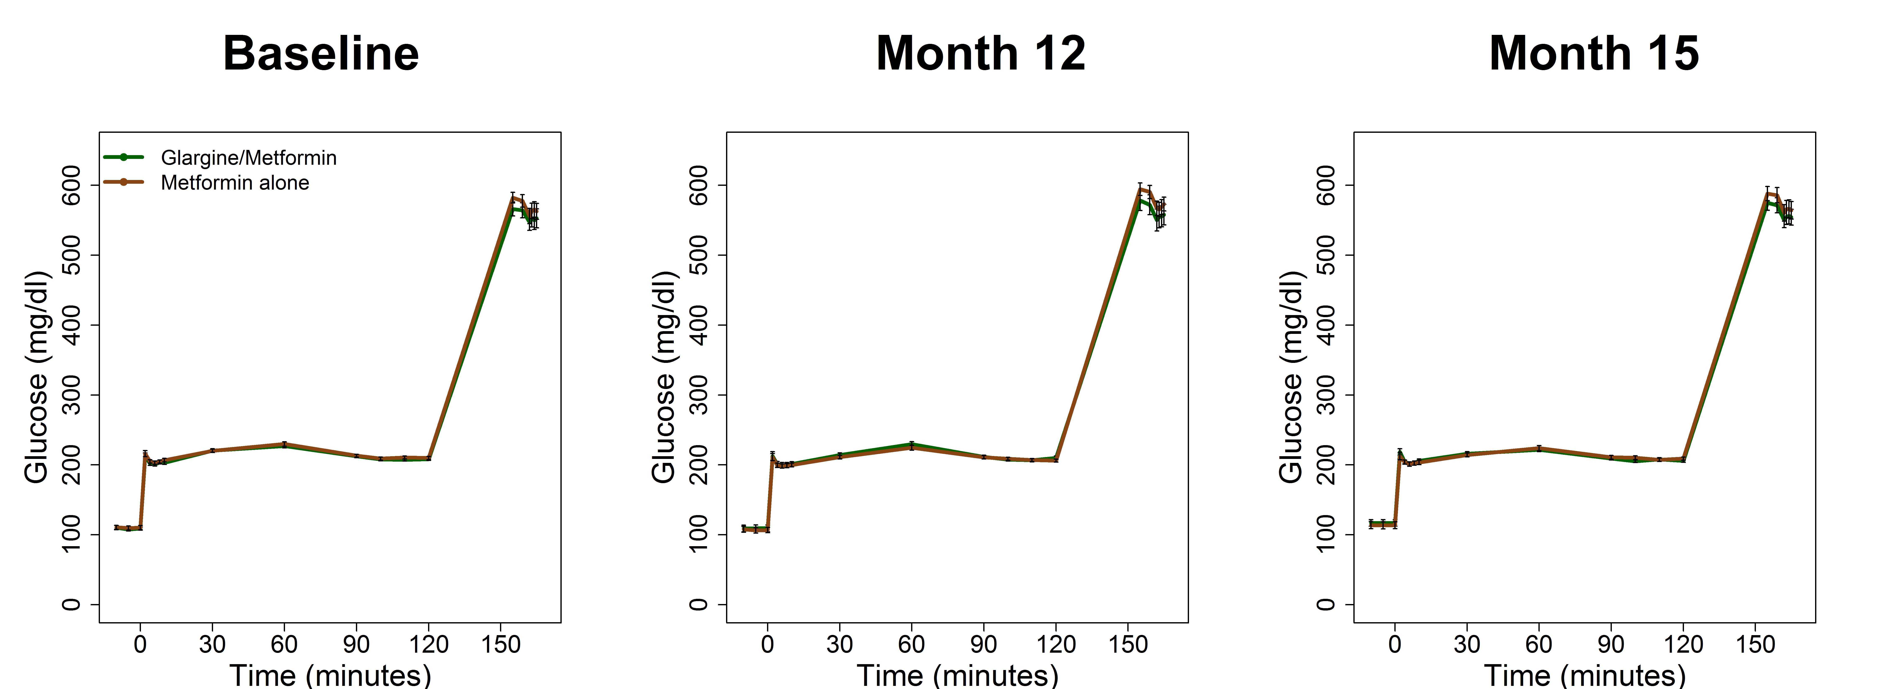
Achieved Glucose Concentrations During Hyperglycemic Clamps
Baseline Month 12 Month 15
The RISE Consortium: Diabetes Care 41:1717-1725; 2018
Notes:
Figure illustrates glucose concentrations during the hyperglycemic clamps performed at baseline, 12 and 15 months. Notably, identical target glucose concentrations of 200 (11.1 mmol/L) and >450 (25 mmol/L) were achieved and not different between treatment groups at baseline, 12 and 15 months.

Slide 49
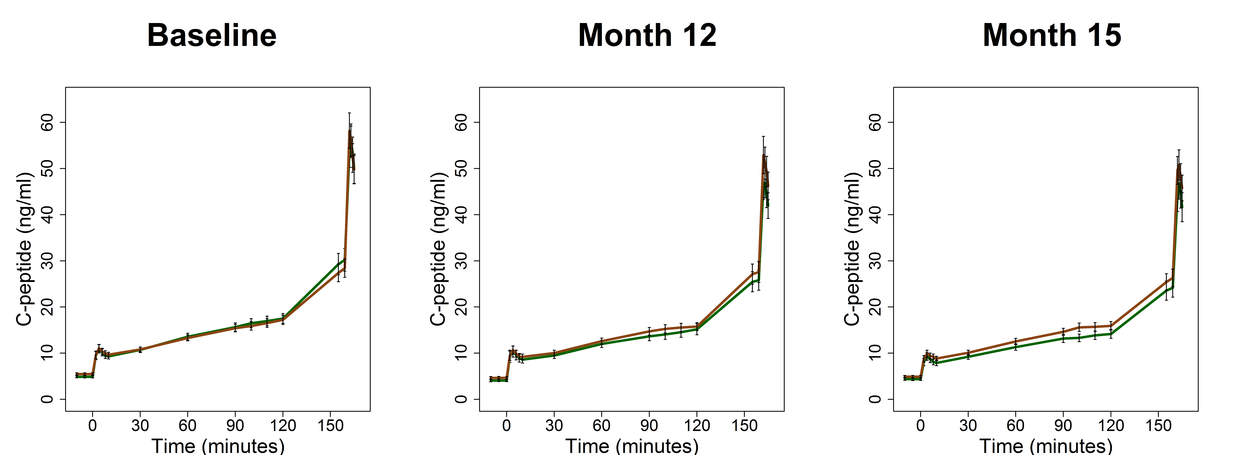
C-peptide Concentrations During Hyperglycemic Clamps
Baseline Month 12 Month 15
The RISE Consortium: Diabetes Care 41:1717-1725; 2018
Notes:
Figure illustrates C-peptide concentrations during the hyperglycemic clamps performed at baseline, 12 and 15 months. Notably, similar C-peptide concentrations were achieved and not different between treatment groups at baseline, 12 and 15 months

Slide 50
Secondary Outcome
One additional β-cell response measure from the hyperglycemic clamp, adjusted for insulin sensitivity:
ACPRg Acute C-peptide response to glucose (first phase response)
The RISE Consortium: Diabetes Care 37:780-788; 2014
Notes:
Two co-primary outcomes were selected which measure different components of ß-cell function.
<enter> The first is the Second phase C-peptide response measured at steady-state of the hyperglycemic clamp at ~200 mg/dl at 100 through 120 minutes of glucose infusion. This is adjusted for insulin sensitivity measured at the at the same time. This represents WHAT??
<enter> and ACPRmax, the arginine-induced acute C-peptide response at glucose above 450 mg/dl also adjusted for insulin sensitivity. This is a measure of β-cell secretory capacity.

Slide 51
Potential Changes in β-cell Responses and Insulin Sensitivity with Interventions
Notes:
1/18

Slide 52
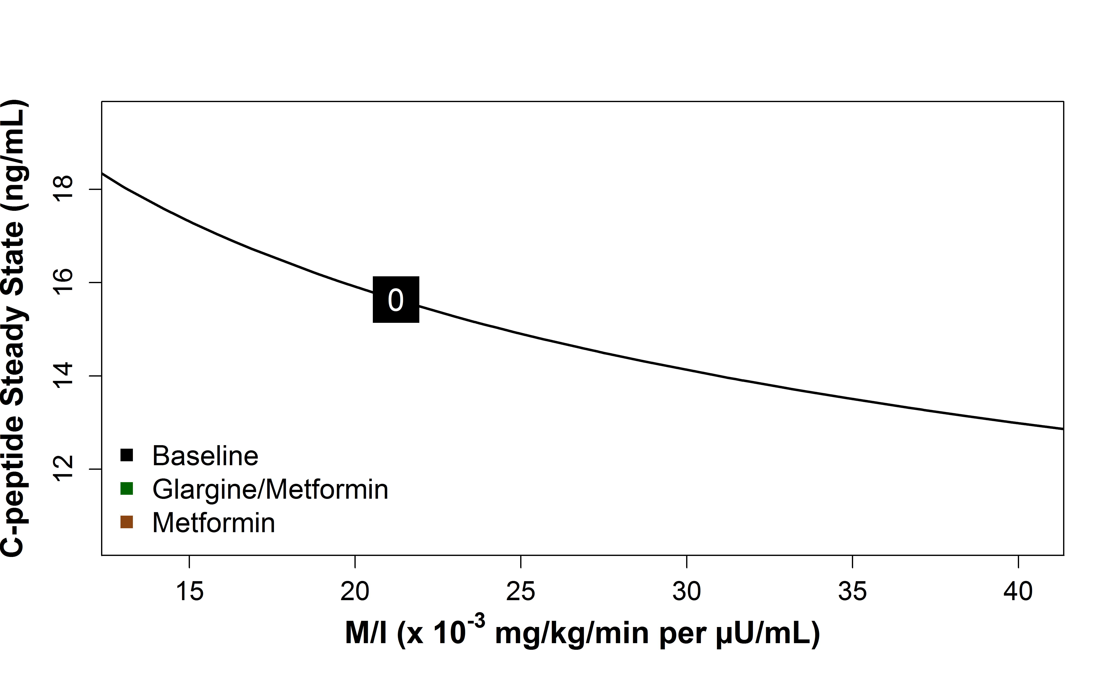
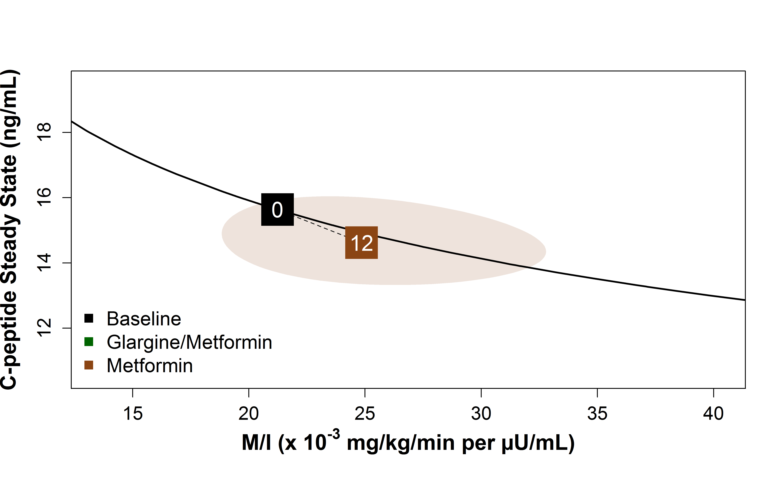
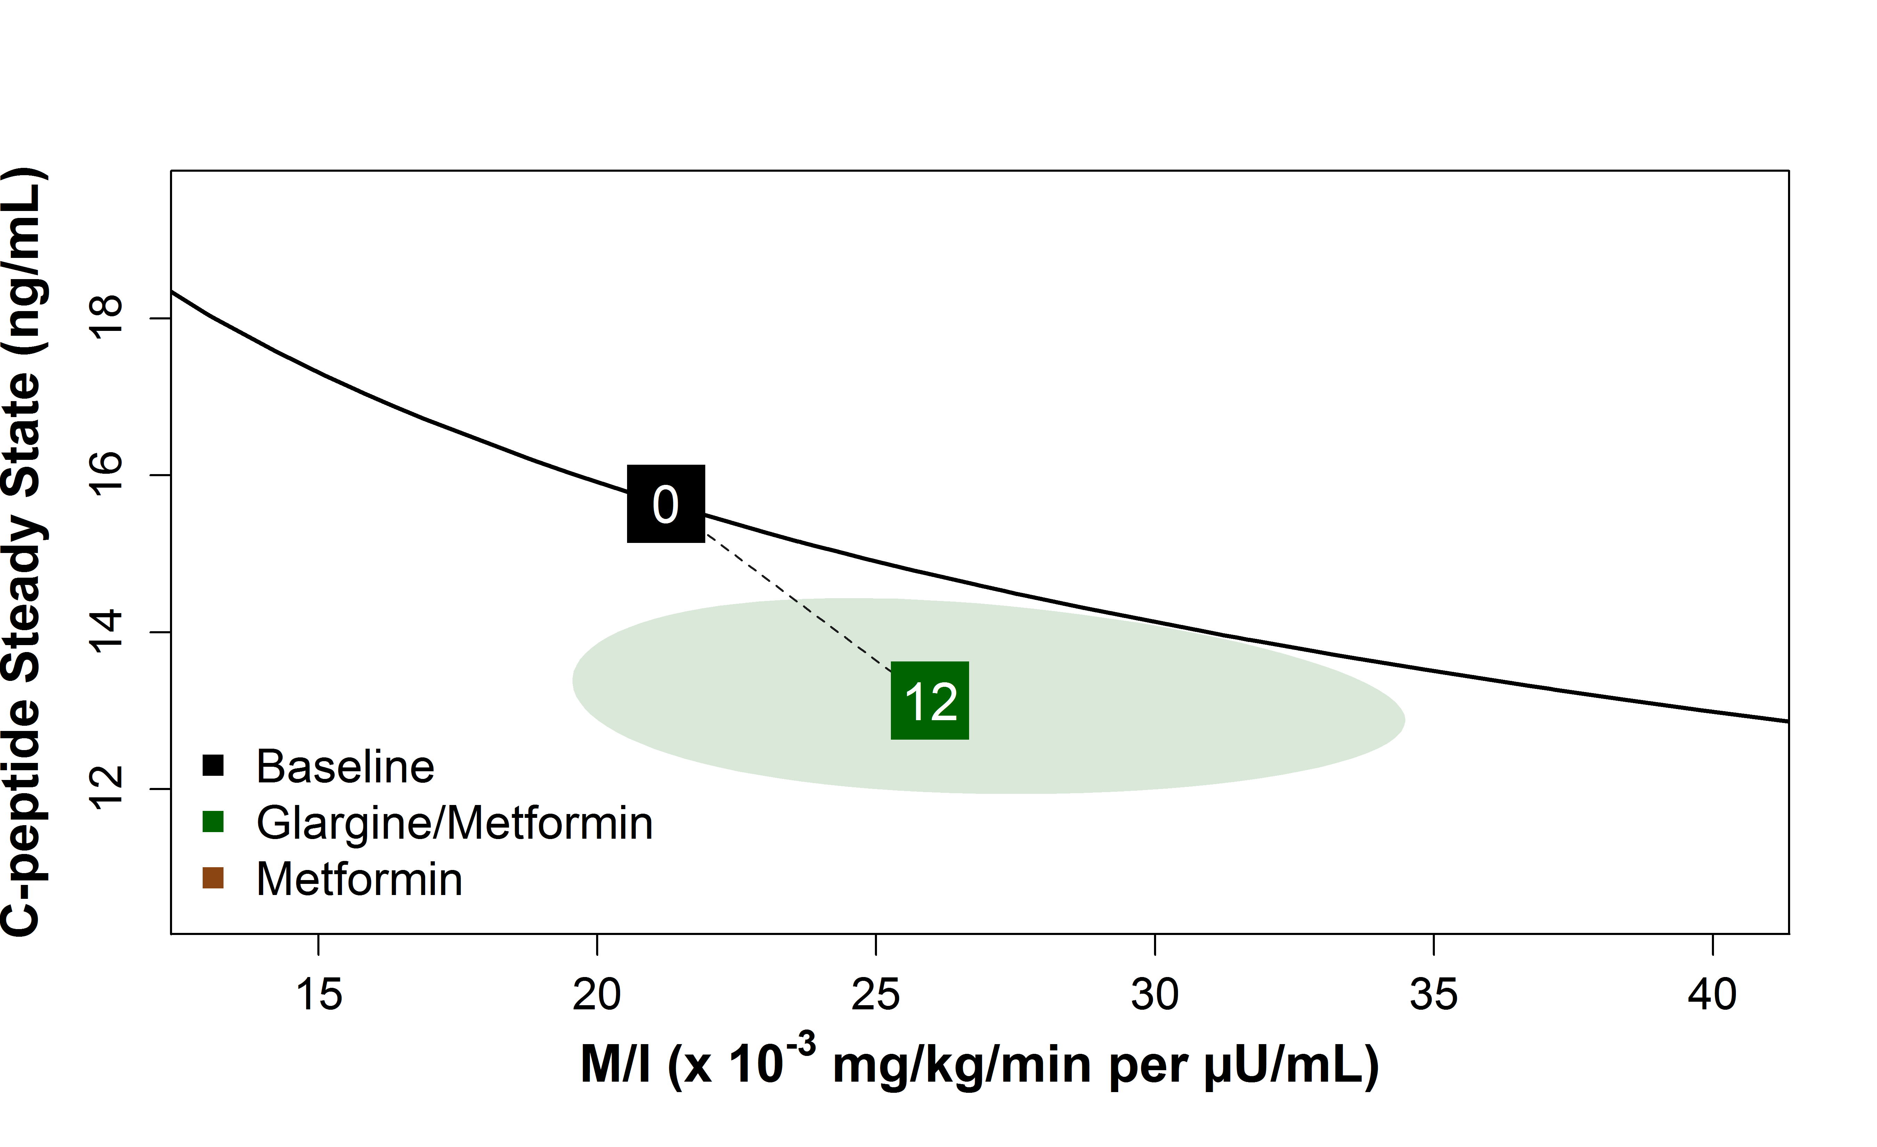
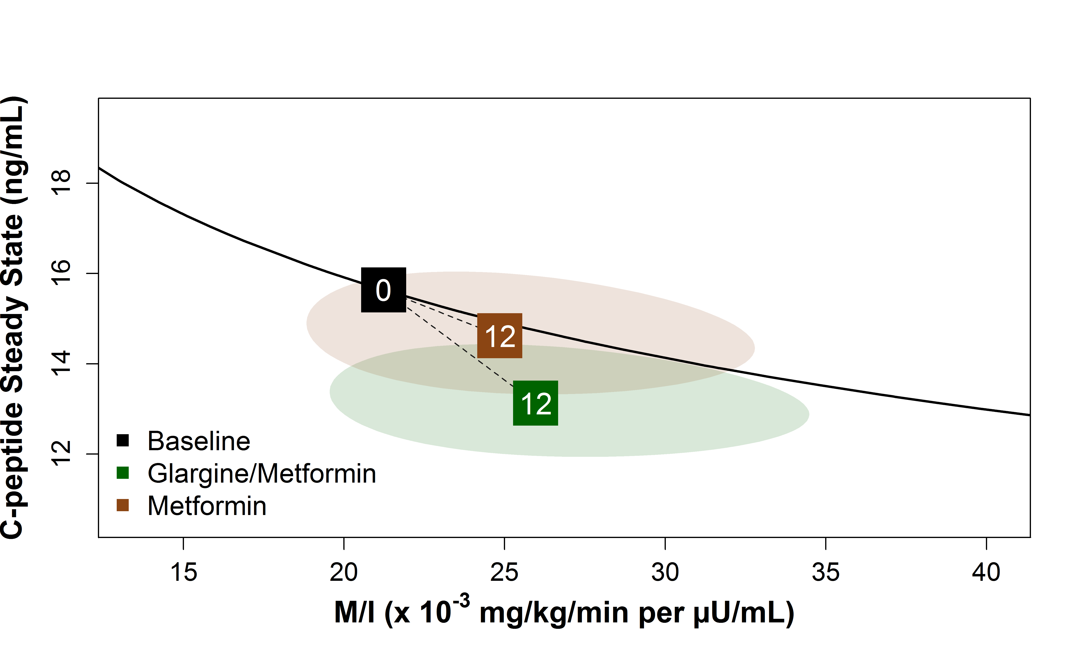
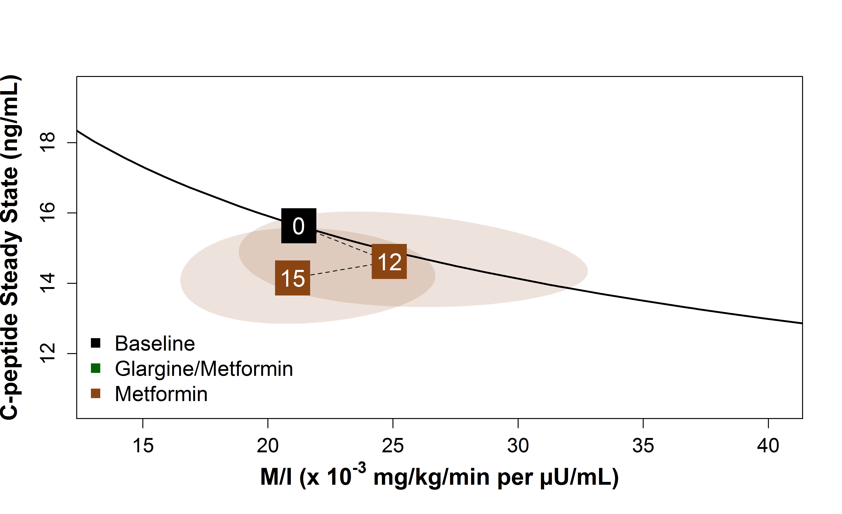
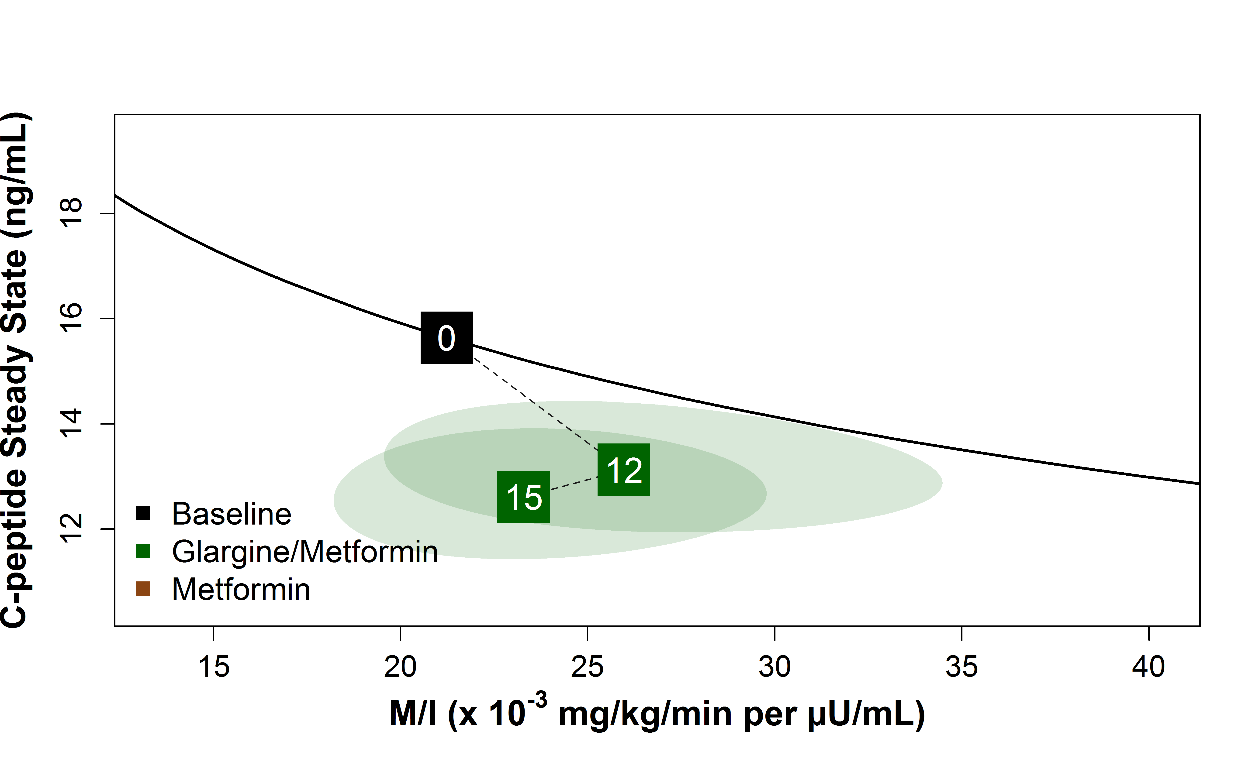
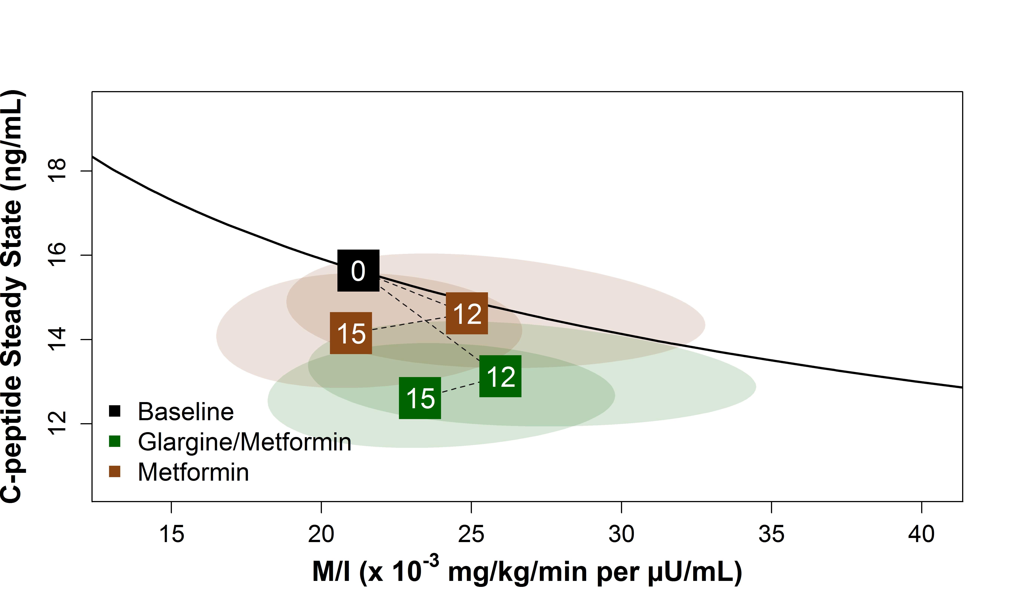
Primary β -cell Function Outcome: Steady-State C-peptide Paired with Insulin Sensitivity
The RISE Consortium: Diabetes Care 41:1717-1725; 2018
Notes:
Figure shows a vector plot of changes from baseline at 12 and 15 months for the co-primary clamp-derived β-cell response of steady-state C-peptide paired with insulin sensitivity (M/I). In these vector plots, the black line depicts the joint relationship between β-cell response and M/I at baseline for the full cohort, with the mean value indicated by the black box. The arrows to points at months 12 and 15 show the average changes from baseline to 12 months of intervention and then to 3 months following discontinuation of the intervention (15 months). Values above the black line represent improved β-cell function and values below the black line indicate poorer β-cell function; the greater the distance from the black line the greater the change. The green arrow and points represent the G followed by M group and the brown arrows and points represent the M group.
(Two participants in the G+M arm met HbA1c criteria for study withdrawal at 9 months and did not complete the 15-month visit. Including the imputed values for their β-cell responses and M/I did not alter the results).
There were no significant differences between treatment groups at 12 or 15 months in the primary measure of β-cell function, steady-state C-peptide paired with insulin sensitivity (M/I), ie neither treatment improved nor maintained β-cell function at the end of or after active treatment. Rather, β-cell function declined significantly from baseline while on active treatment through 12 months within each treatment group for steady-state C-peptide with M/I (G+M: p=0.019, M: p=0.025) β-cell function remained significantly worse at 15 months compared to baseline within both treatments for steady-state C-peptide with M/I (G+M: p<0.001, M: p=0.031).

Slide 53
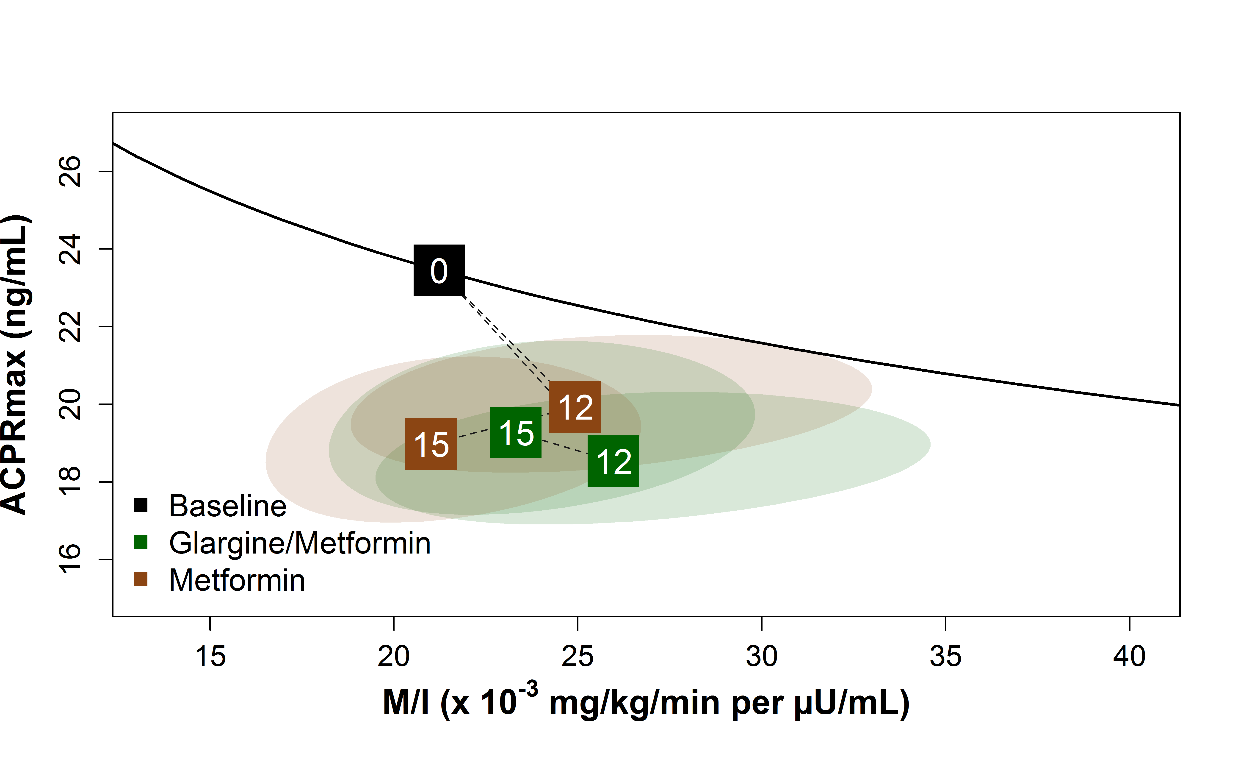
Primary β-cell Function Outcome: ACPRmax Paired with Insulin Sensitivity
The RISE Consortium: Diabetes Care 41:1717-1725; 2018
Notes:
Similarly, there were no significant differences between treatment groups at 12 or 15 months in the primary measures of β-cell function [e.g., response, ACPRmax, paired with insulin sensitivity (M/I). Two participants in the G+M arm met HbA1c criteria for study withdrawal at 9 months and did not complete the 15-month visit. Including the imputed values for their β-cell responses and M/I did not alter the results.
As can be seen in Figure, neither treatment improved nor maintained β-cell function at the end of or after active treatment. Rather, β-cell function declined significantly from baseline while on active treatment through 12 months within each treatment group for ACPRmax with M/I (G+M: p<0.001, M: p=0.001). β-cell function remained significantly worse at 15 months compared to baseline within both treatments for ACPRmax with M/I (G+M: p=0.001, M: p<0.001).

Slide 54
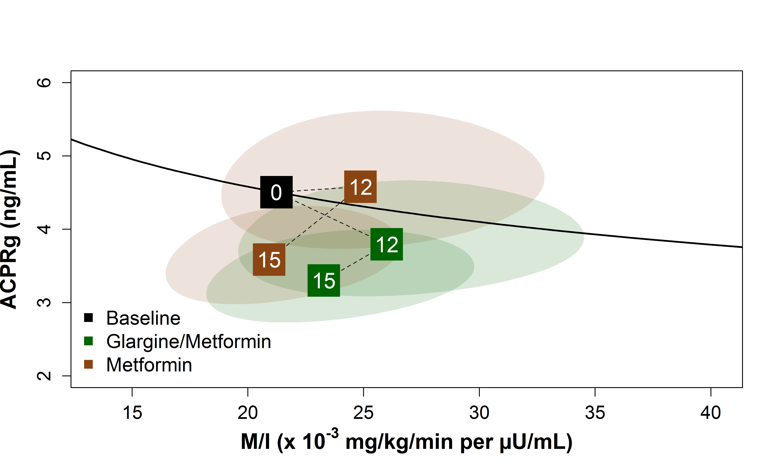
Secondary β-cell Function Outcome: ACPRg Paired with Insulin Sensitivity
The RISE Consortium: Diabetes Care 41:1717-1725; 2018
Notes:
There were no significant differences between treatment groups at 12 or 15 months in the secondary measures of β-cell function [ACPRg paired with insulin sensitivity (M/I)]. Figure shows a vector plot of changes from baseline at 12 and 15 months for the secondary clamp-derived β-cell response [ACPRg paired with insulin sensitivity (M/I)]. In these vector plots, the red line depicts the joint relationship between β-cell response and M/I at baseline for the full cohort, with the mean value indicated by the point. Two participants in the G+M arm met HbA1c criteria for study withdrawal at 9 months and did not complete the 15-month visit. Including the imputed values for their β-cell responses and M/I did not alter the results.
As can be seen in Figure neither treatment improved nor maintained β-cell function at the end of or after active treatment. Rather, β-cell function declined significantly from baseline while on active treatment through 12 months within each treatment. β-cell function remained significantly worse at 15 months compared to baseline within both treatments ACPRg with M/I (G+M: p<0.001, M: p=0.014).

Slide 55
What about the Subset of Youth with Impaired Glucose Tolerance?
Approach:
Examine β-cell function in 54 youth with IGT at time of enrollment.
Participants:
26 in glargine followed by metformin group
28 in metformin alone group
The RISE Consortium: Diabetes Care 41:1717-1725; 2018

Slide 56
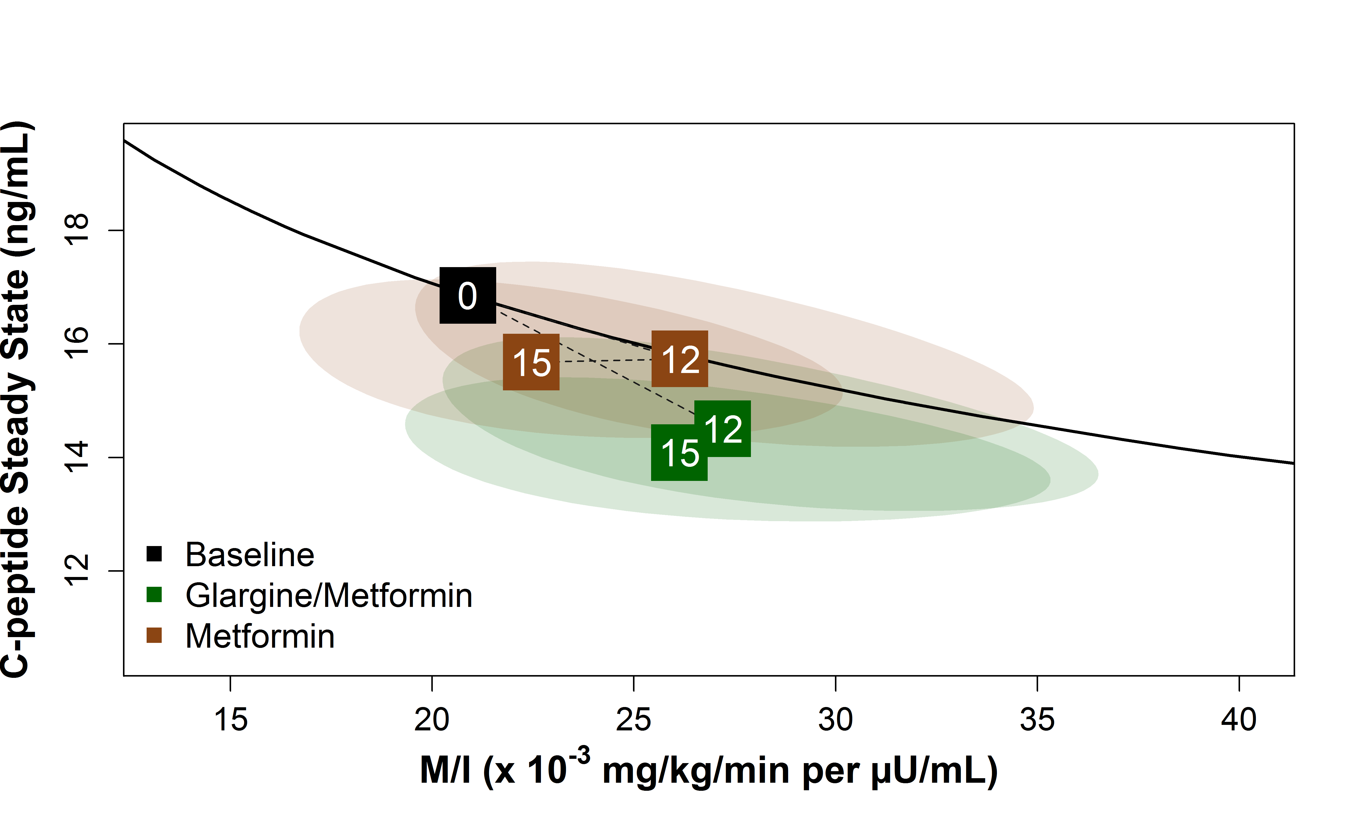
Steady-State C-peptide Paired with Insulin Sensitivity in Participants with IGT at Baseline
The RISE Consortium: Diabetes Care 41:1717-1725; 2018
Notes:
There were no significant differences between treatment groups at 12 or 15 months in either of the primary measures of β-cell function [steady-state C-peptide), paired with insulin sensitivity (M/I)] in IGT

Slide 57
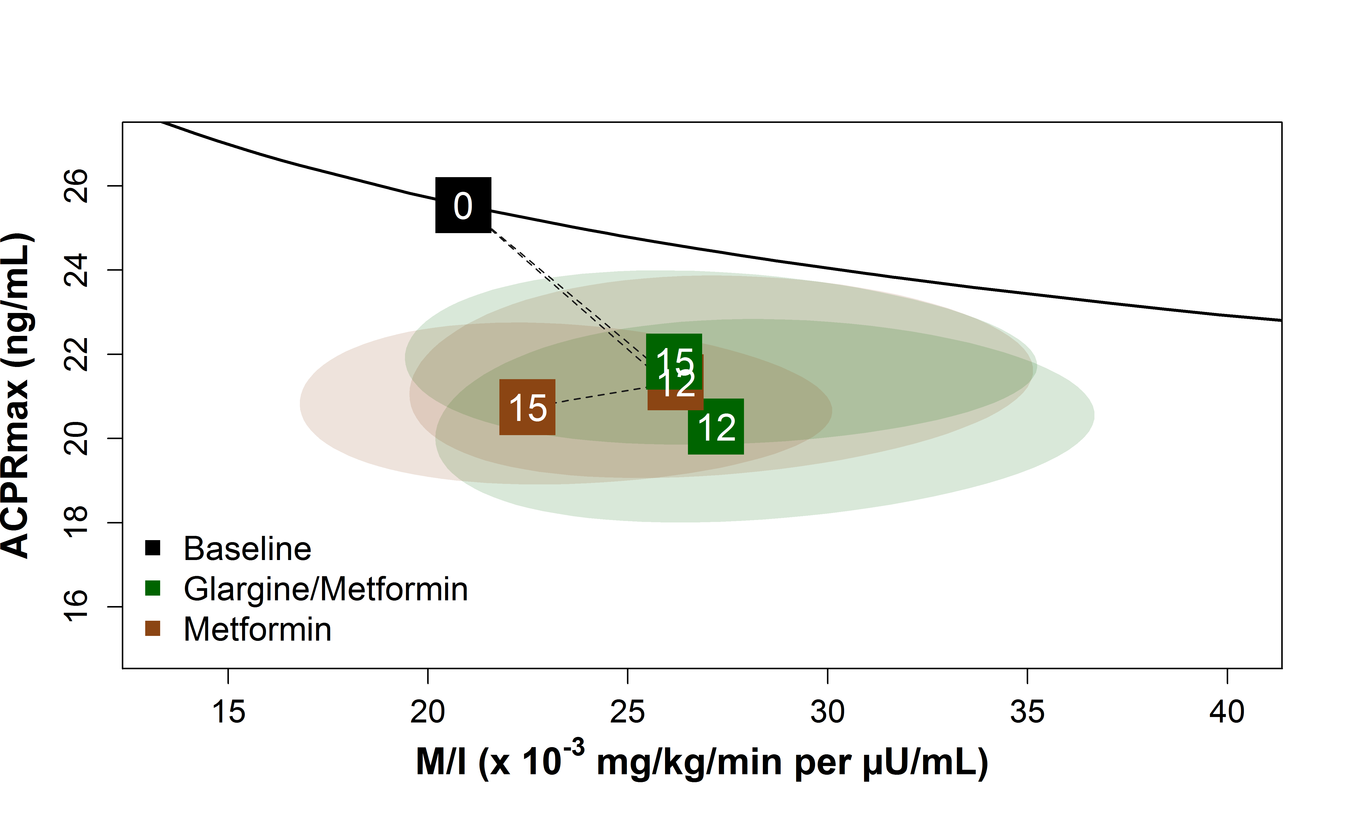
ACPRmax Paired with Insulin Sensitivity in Participants with IGT at Baseline
The RISE Consortium: Diabetes Care 41:1717-1725; 2018
Notes:
There were no significant differences between treatment groups at 12 or 15 months in either of the primary measures of β-cell function [e.g., response (ACPRmax), paired with insulin sensitivity (M/I) in IGT

Slide 58
Summary
Overall retention, medication adherence and hyperglycemic clamp quality and reproducibility over time were excellent
At 12 and 15 months there were no significant differences in measures of β-cell function between treatment groups
Within each treatment group, β-cell function worsened over time despite intervention
The pattern of β-cell function loss was identical in youth with IGT

Slide 59
RISE Pediatric Medication Study
Secondary Outcomes

Slide 60
Adverse Glycemic Outcomes
New onset diabetes (2-hour glucose ≥200 mg/dL and HbA1c ≥6.5%):
Over 15 months, three participants with IGT at baseline assigned to glargine followed by metformin developed diabetes. No IGT participants in the metformin alone arm developed diabetes.
Severe hyperglycemia
Glargine followed by metformin: three participants at 15 months
Metformin alone: two participants at 12 months and one at 15 months
No participant experienced severe hypoglycemia, acute metabolic decompensation, or ketoacidosis
The RISE Consortium: Diabetes Care 41:1717-1725; 2018

Slide 61
Targeted Adverse Events
Targeted adverse events were as expected:
36% of participants experienced mild hypoglycemia during glargine therapy
37% of participants reported gastrointestinal discomfort
23% of participants reported polyuria/polydipsia
The RISE Consortium: Diabetes Care 41:1717-1725; 2018

Slide 62
Serious Adverse Events
Seven serious adverse events reported:
suicidal ideation/anxiety
Ewing's sarcoma
otitis externa
appendicitis/appendectomy
pneumonia
tonsillectomy/adenoidectomy (two)
None of these serious adverse events were determined to be related to the interventions
The RISE Consortium: Diabetes Care 41:1717-1725; 2018

Slide 63
Summary
Metformin had a small, but measurable, effect on BMI, which was not sustained after withdrawal of therapy
Both treatments were initially effective at lowering HbA1c
Neither treatment had a sustained effect on HbA1c, which rose after withdrawal in both groups and was higher than baseline at 15 months
Neither intervention had any effect to change cardiovascular risk factors

Slide 64
Thanks
@RISEDiabetesStudy
@RISEstudy
rise@bsc.gwu.edu
#RISEstudy
http://care.diabetesjournals.org/collection/rise-consortium

